Slide 1
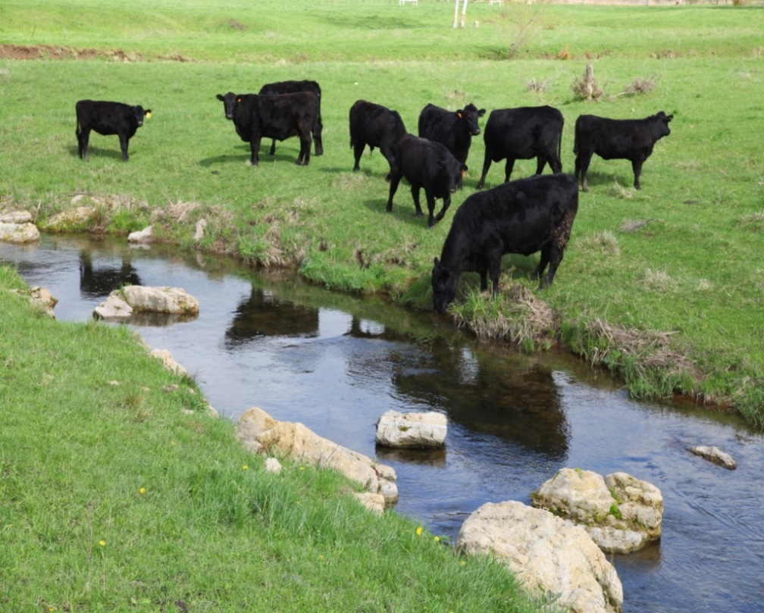
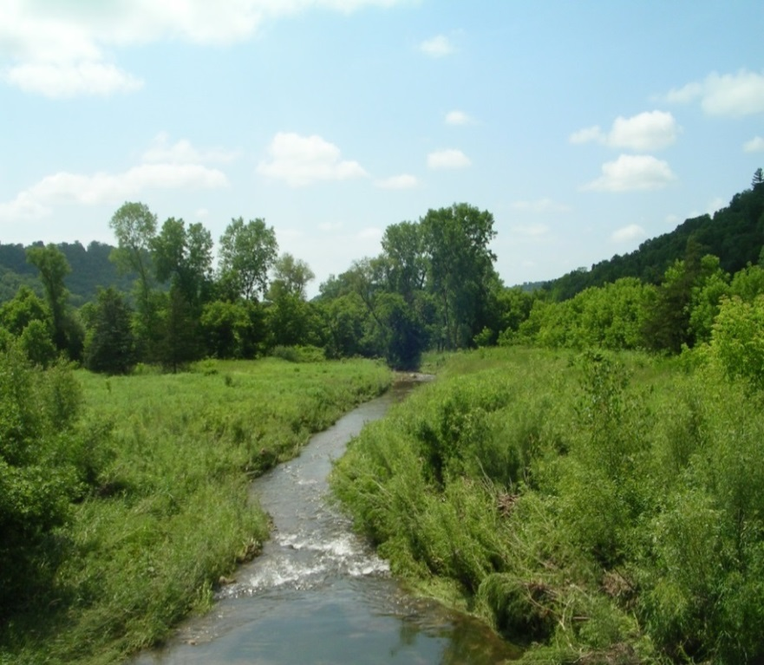
Grazing Spring Coulee Creek
Grazing in Spring Coulee
Ungrazed, unrestored stretch
Images Courtesy of Willow Creek Ranch
Slide Source:
Allen Williams

