Slide 1
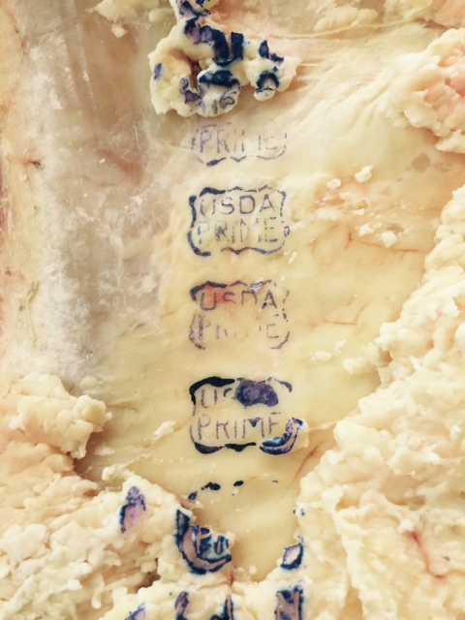
Grass Fed Potential
Slide Source:
Allen Williams

