Slide 1
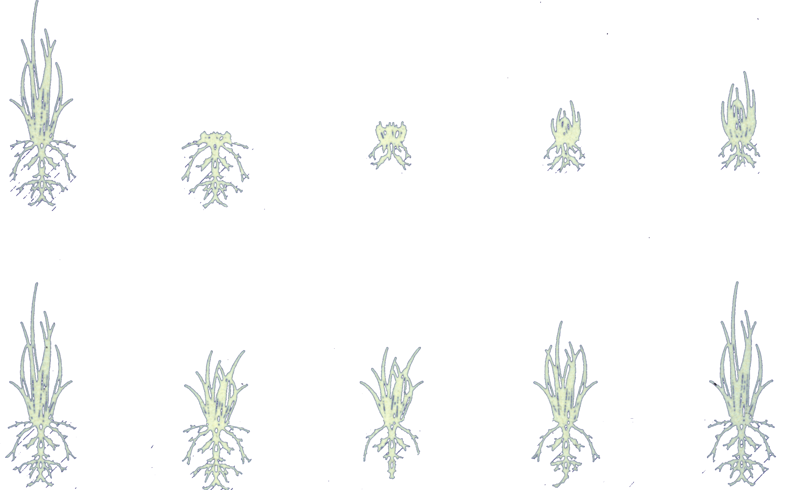
A
B
PLANTS
AT START
EXTENT OF
GRAZING
5 DAYS
RECOVERY
10 DAYS
RECOVERY
15 DAYS
RECOVERY
Slide Source:
Allen Williams

