Slide 1
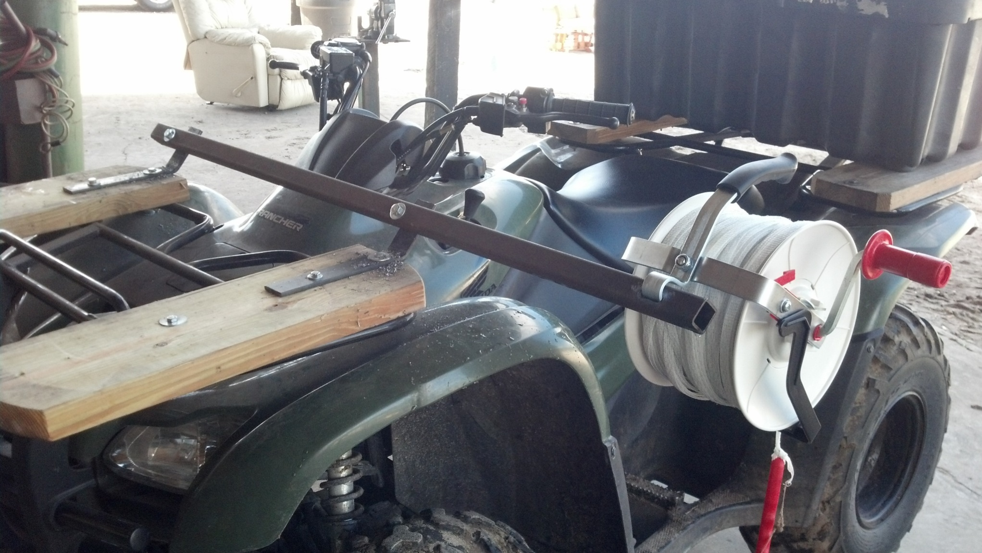
Slide Source:
Allen Williams

