Slide 1
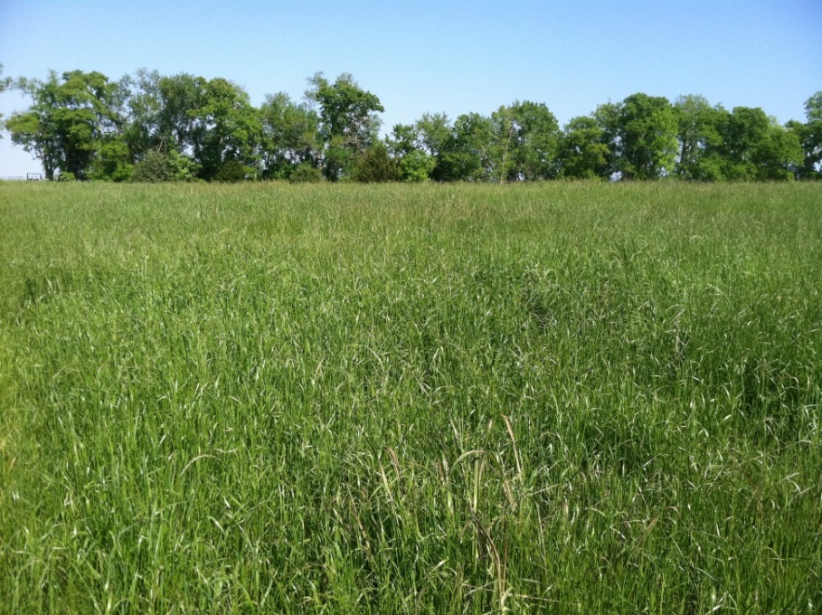
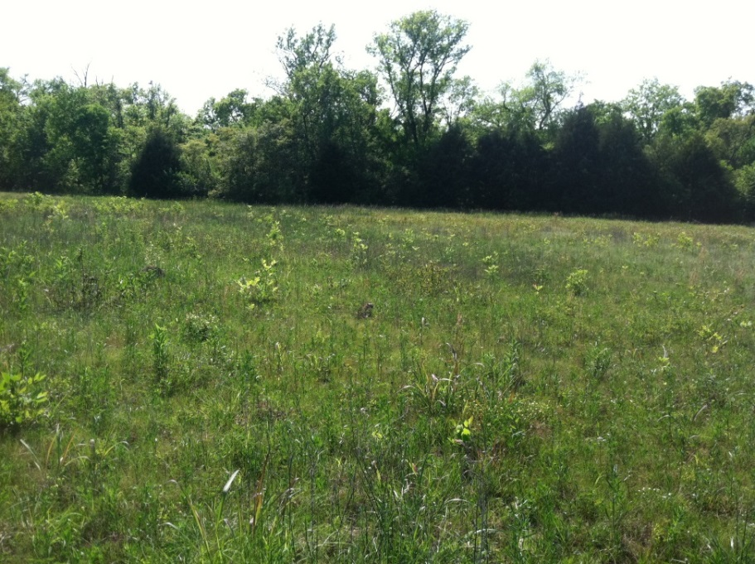
Bird-Friendly Grazing
New paddock with over 20 documented species
Pasture after hard grazing with cover remaining for birds
Images courtesy of Dr. Allen Williams
Slide Source:
Allen Williams

