Slide 1
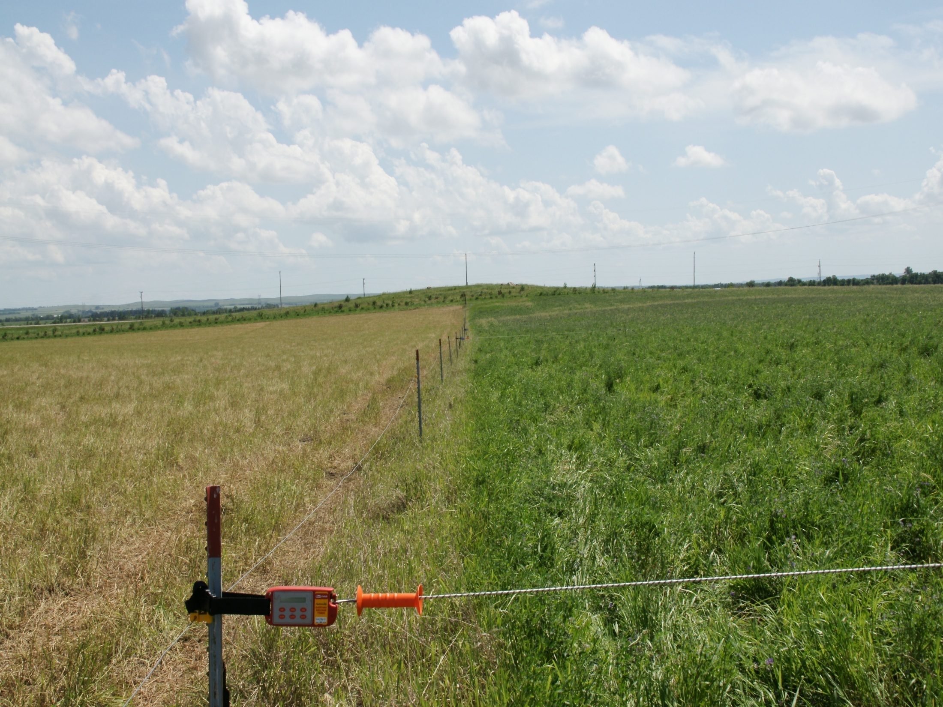
Batt Latch
Slide Source:
Allen Williams

