Slide 1
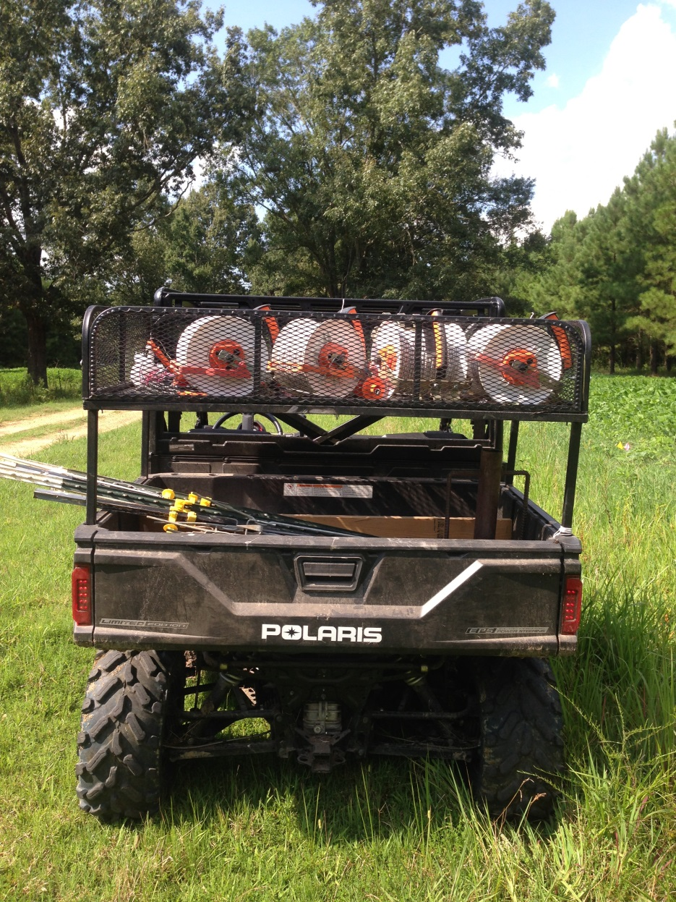
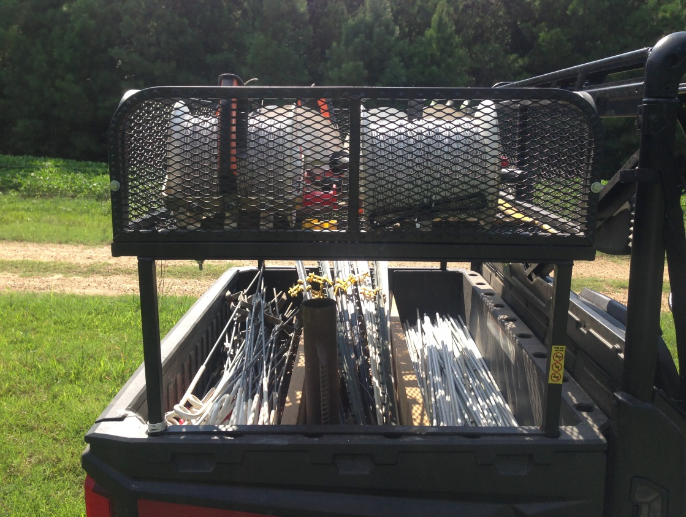
Allen’s Fencing Rig
Slide Source:
Allen Williams

