Slide 1
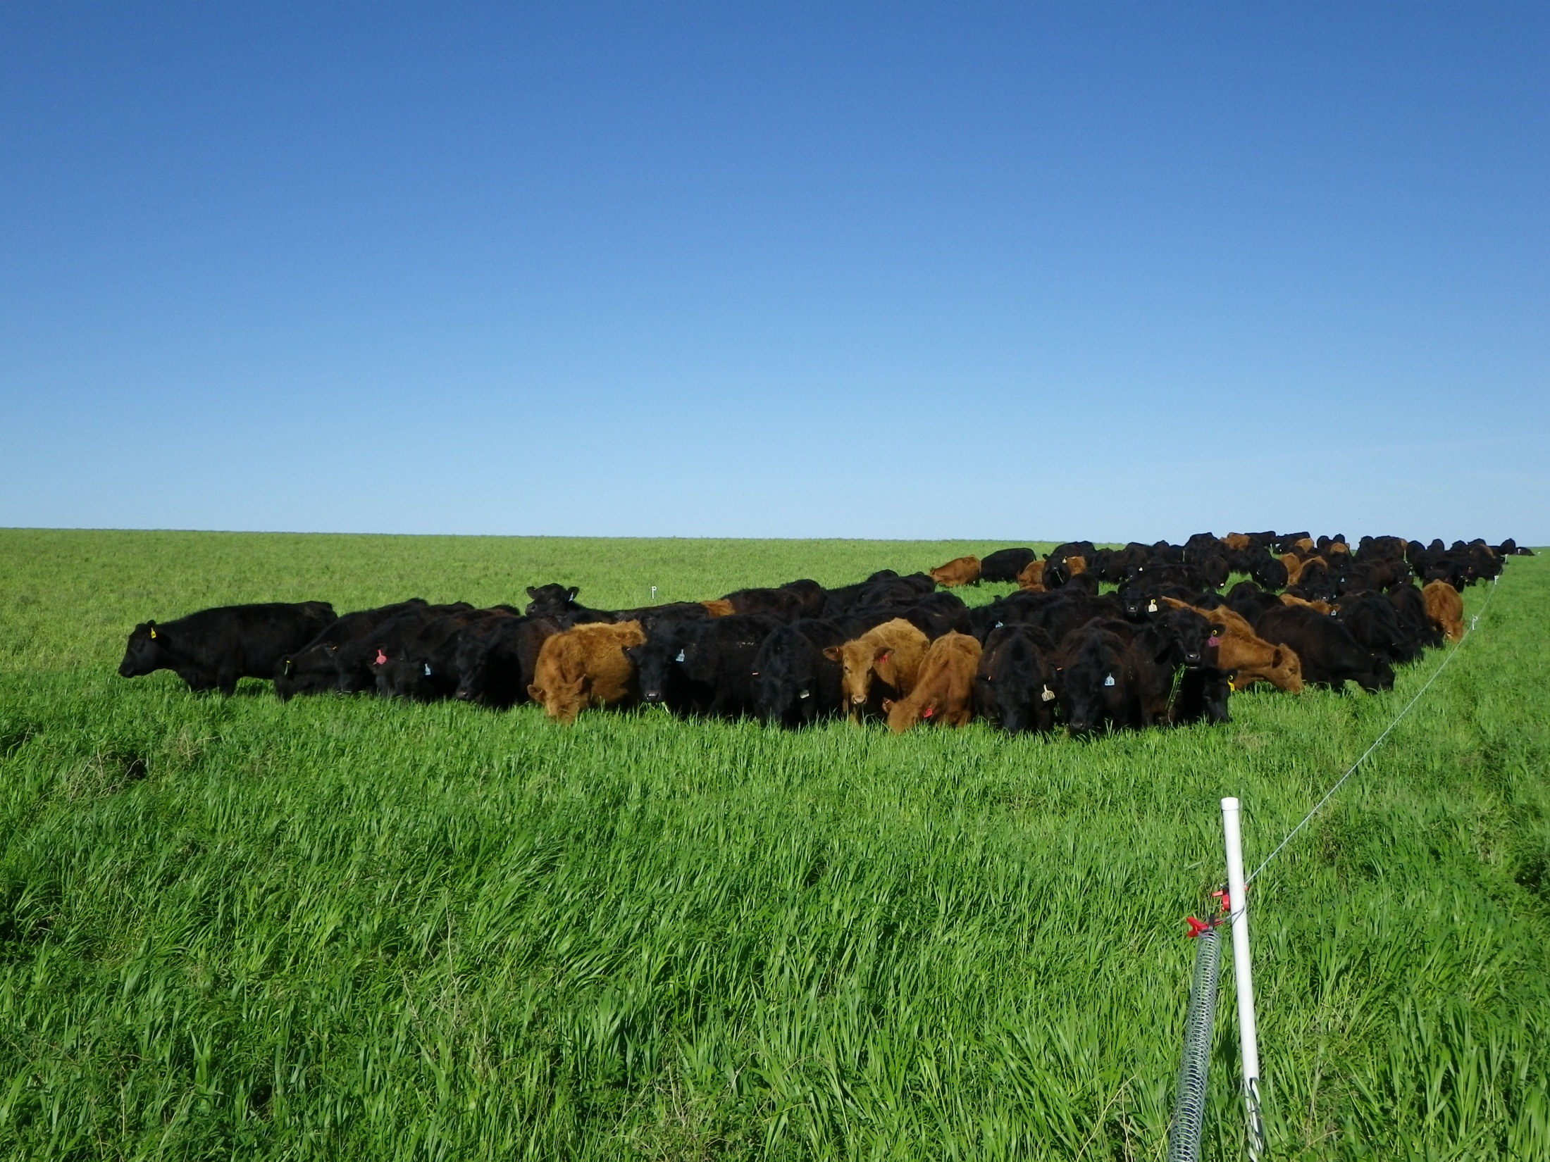
500,000 lbs per Acre
Slide Source:
Allen Williams

