Slide 1
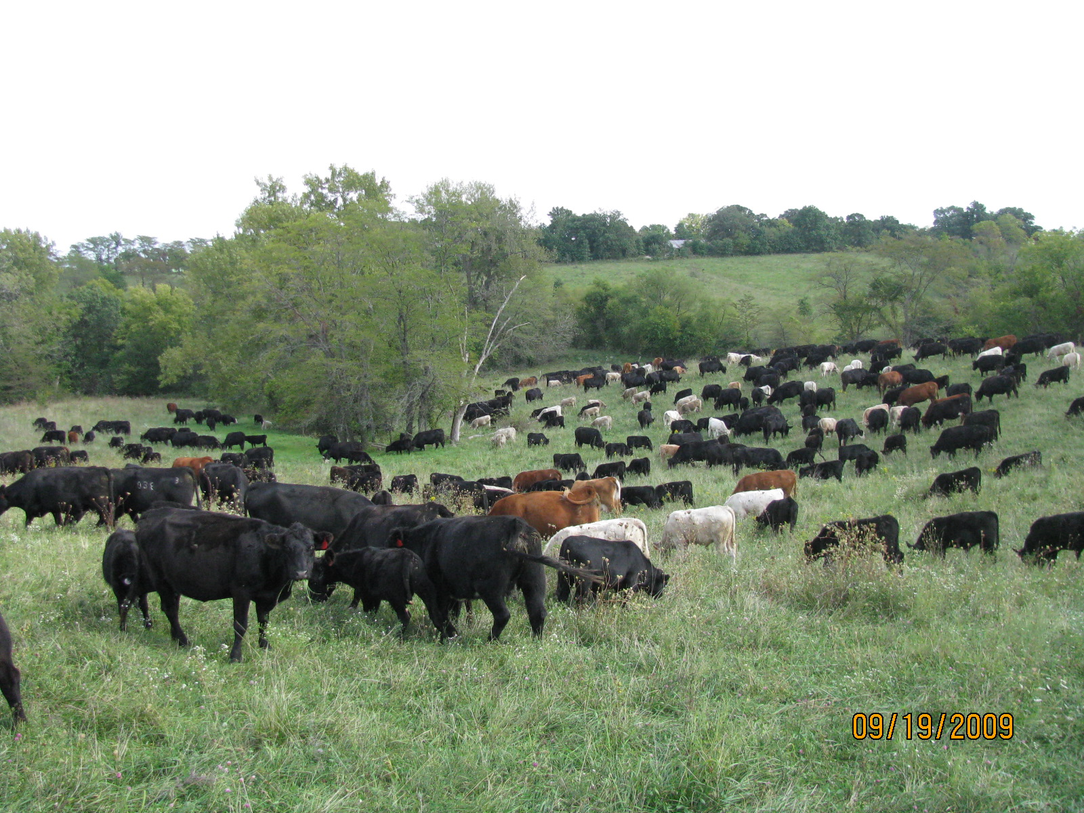
Adaptive High Stock Density Grazing
250,000 lbs per Acre
Slide Source:
Allen Williams
Notes:
Here is a set of cows at almost 150,000 stock density. Actually the photo appears to be a little higher than that because the 250 pair have access to 3 acres but they are standing on only about 2 acres of the field. Again, we are taking a look at how closely they are spaced. When I talk to people about putting that many cattle on 2-3 acres they always ask “can they even fit on that small of an area”? Do they look smashed together to you? To they look stressed to you?

