Slide 1
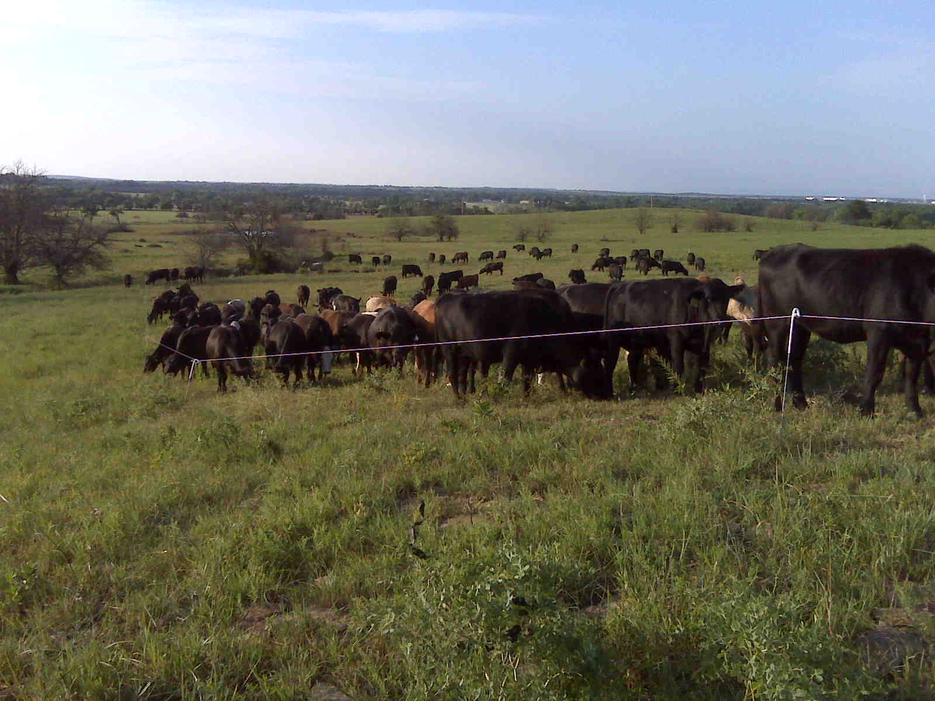
150,000 lbs per Acre
Slide Source:
Allen Williams

