Slide 1
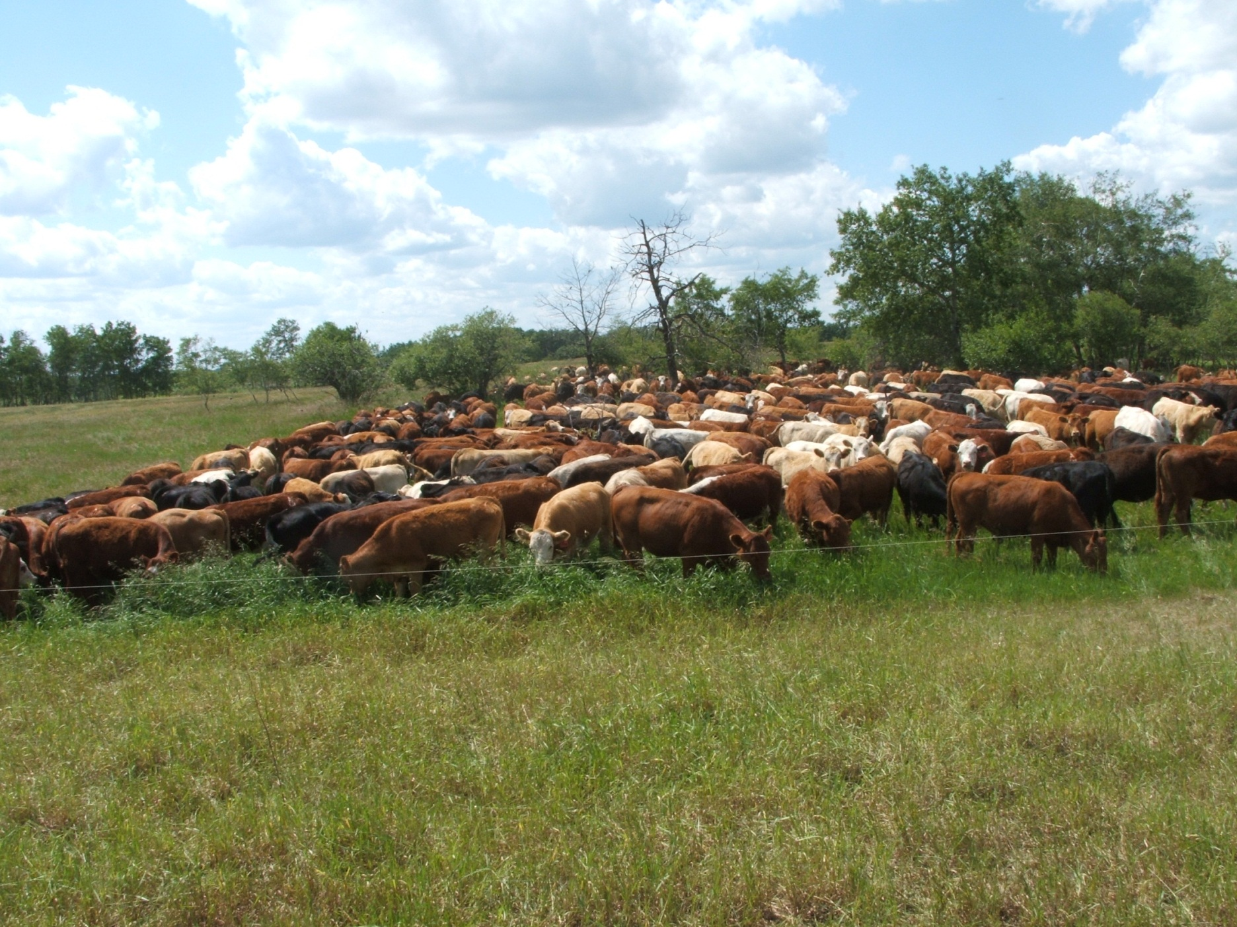
1,000,000 lbs per Acre
Slide Source:
Allen Williams

