Slide 1
Upper Midwest Grazing Educators Webinar Series
Teaching Resources Roundtable
October 9th, 2015

Slide 2
Hosted by Warren King and Jane Jewett
Co-manager of the Pasture Project
President of WellSpring, Ltd
Work focused on expanding environmentally sustainable farming, developing local & regional food systems and improving water quality
Research Fellow, University of Minnesota
Green Lands Blue Waters Initiative

Slide 3
Webinar Technical Orientation
Notes:
Welcome! This is a quick overview of the basic features of the cluster call software.

Slide 4
Your Starting Screen
Presentation
Control Panel
Notes:
Your screen should look something like this.

Slide 5
To Ask a Question
Type your question in the small box at the bottom of the chat box.
If possible, specify which panelist(s) you are addressing with your question.
Press “Send”!
Notes:
To interact with the panelist(s) or tech support, use the Questions box. Most questions will be addressed after the formal presentation during the Q&A time, but if you need clarification on a point, or have technical difficulties, ask at any time.

Slide 6
Post-Webinar Survey
We will be sending out a survey following the webinar.
These surveys help to make for a better experience for everyone involved, if you could please take a moment to fill them out, it would be of great help to us.
Notes:
At the conclusion of the Cluster Call your browser will open showing a very brief survey. Please take a minute or two to fill it out so that we can continue to make the Cluster Calls a valuable service to you.

Slide 7
Who’s Sponsoring the webinar series?
Green Lands Blue Waters
The Pasture Project
Goals
Increase perennial forage and pasture
Improve environmental performance of farming
Maintain production and profitability
Goals
Expand grass-based livestock production
Accelerate transition to sustainable farm production
Improve water quality

Slide 8
Why Focus on Grazing Educators?
The Upper Midwest is a unique geography
More young farmers are interested in livestock production
More landowners and conservationist are interested in livestock benefits
More consumers want pasture raised meat and dairy products
Less public funding for grazing networks and education
Fewer professional development opportunities for educators
Changes in grazing techniques and terminology
No single source for education materials

Slide 9
What Could a Grazing Educator Network Achieve?
Connect Upper Midwest Educators through discussion and sharing
Assess education materials-tool; determine what’s missing and fill the gaps
Create a platform to house and access materials and tools
Share what works and why
Cross-pollination of staff, students, apprentices and programs
Involve established grazing education programs
Access materials-tools no longer in circulation
Build collaboration that is more “grass-roots” than “top-down”
Include educators of various types; farmers, academics, agency and consultants
Establish basic principles of managed grazing that are taught by all

Slide 10
What is the format for today’s webinar?
Presenters will present in four short segments, discussing resources for Grazing Education
Audience is encouraged to engage in the discussion
Moderators will “direct the traffic” and keep discussion moving

Slide 11
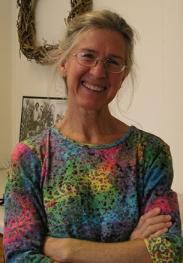
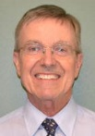
Doug Gucker is a Local Food Systems and Small Farms Extension educator with University of Illinois Extension.
He works with local producers and consumers to increase the availability of locally grown foods. In addition, his duties include being a local resource for agricultural issues within the DeWitt, Macon, & Piatt County unit.
Doug has bachelor degrees in biology and agronomy and a master's degree in agronomy. He is an Illinois Certified Crop Adviser (CCA)
His professional affiliations include the American Society of Agronomy and the Soil and Water Conservation Society.
Caroline van Schaik works with farmers and landowners in the Root River watershed of southeast Minnesota as an organizer with the Land Stewardship Project.
While cover crops, field research, conservation leases, healthy soil, custom grazing, and other aspects of agriculture occupy her with both men and women, part of her time is focused specifically on the needs of women and their expressions of land management.
She and her family run sheep on an intensely managed grazing farm near the Mississippi River.

Slide 12
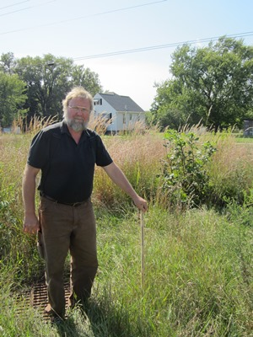
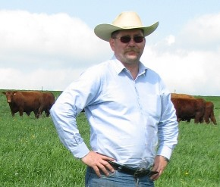
Gene Schriefer has been the Agriculture Agent with the University of Wisconsin – Extension for the past 6 years working primarily in Iowa County in the Driftless Region.
He organizes and leads the Southwest Wisconsin grazing network which hosts a dozen pasture walks a season and the spring and fall grazing workshops.
Prior to his extension position, he was the Grazing Specialist for Southwest Badger RC&D developing grazing management plans and grazing education for farmers and land owners in the seven southwestern counties of the Driftless region.
Gene owns and manages a small farm in Dodgeville, WI grazing a white faced, commercial flock and crossbred beef herd focused on grass finished beef.
Vance J. Haugen is a University of Wisconsin Agriculture Extension Agent (since 1985) and is currently a county based faculty member located in Crawford County, Wisconsin.
Vance was raised on a dairy farm near Thief River Falls, Minnesota and earned both his B.S. (1979) and M.S. (1984) degrees from the Ag. Engineering Department at North Dakota State University, Fargo, North Dakota.
For the last 25 years pasture education has been the main focus of his extension work. In addition, since 1993 Vance, with his wife, Bonnie and three children, Inga, Olaf and Thor has operated a 230 acre, grass based dairy near Canton,Minnesota

Slide 13
Grazing In Flat Central Illinois
My three county area has
About 790,000 acres in farmland
751,000 acres in Grain Crops
6,000 acres in Hay Crops
Pasturelands too small to be reportable to USDA
My graziers tend to be small producers on small acres not suited for row crops or houses and usually small ruminants.
Notes:
Welcome! This is a quick overview of the basic features of the cluster call software.

Slide 14
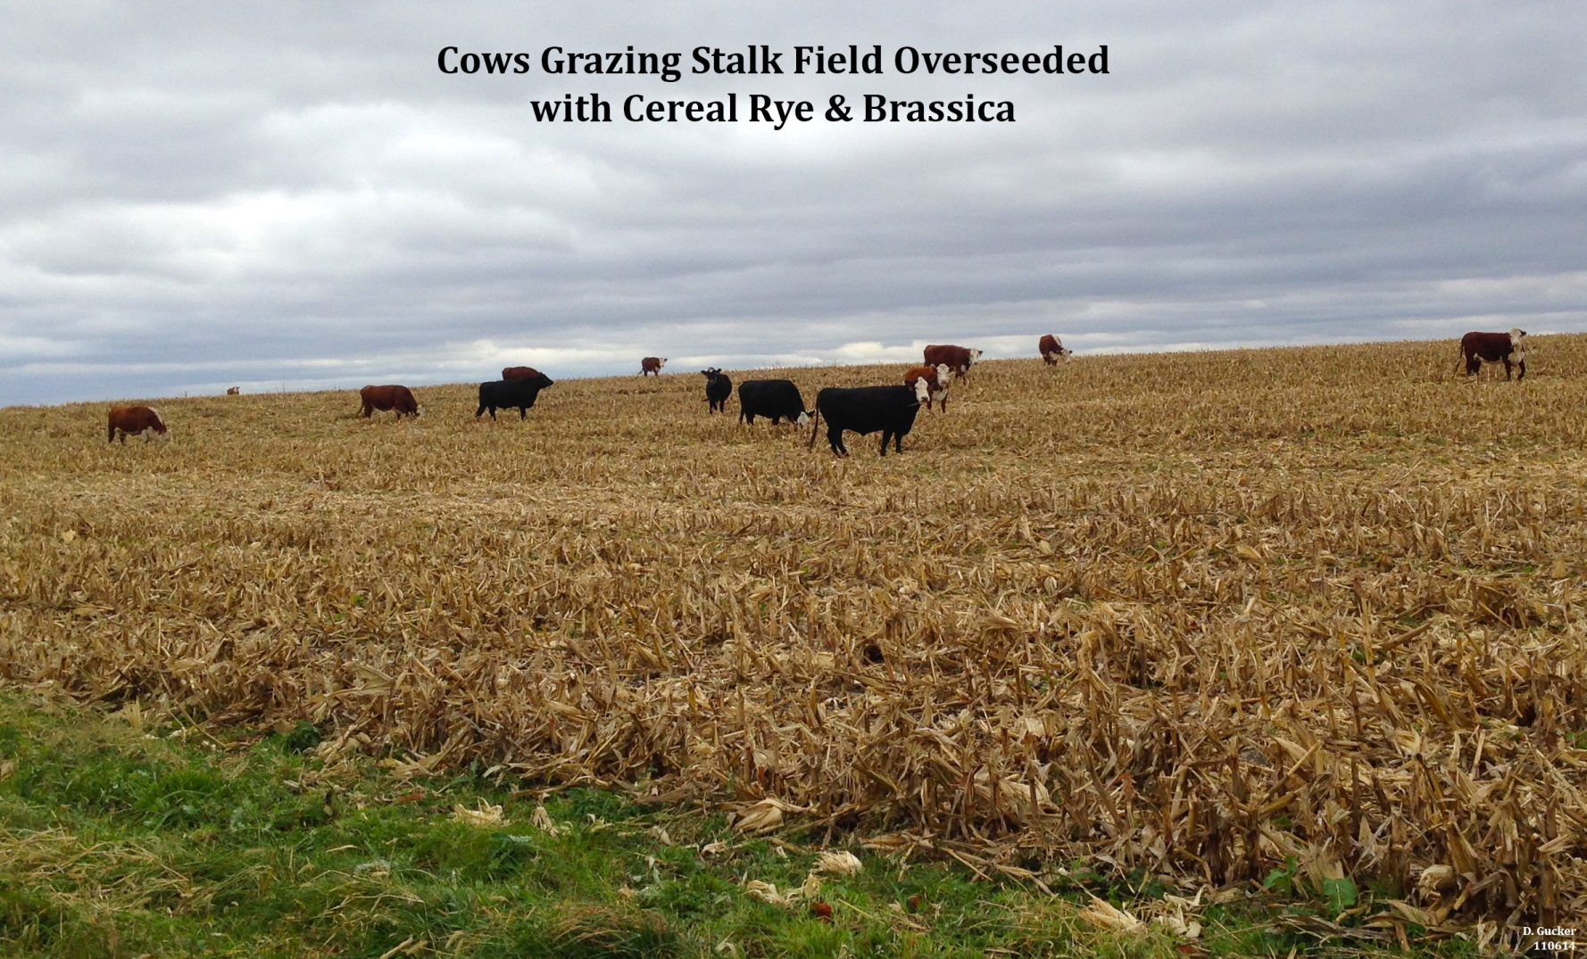
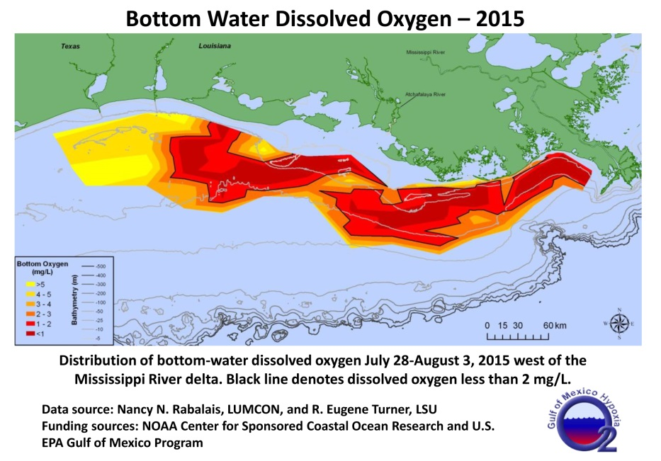

Slide 15
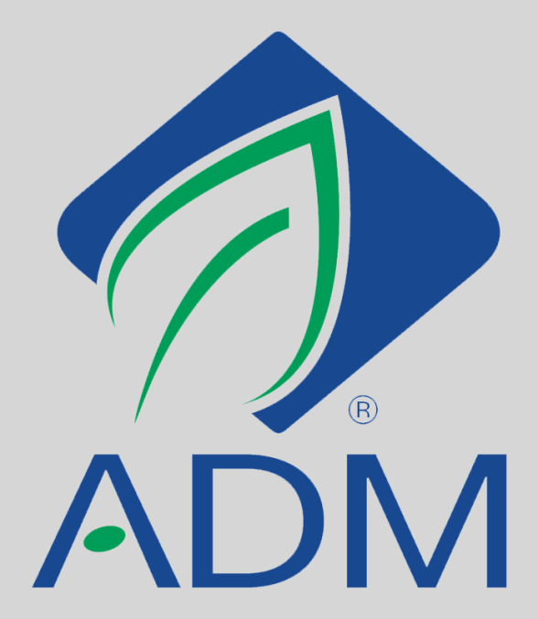
In-State Grazing Research ?
Limited due to a by-products focus
Last grazing specialist left in 2007
Dr. Justin Sexton, University of Missouri (now)
Notes:
Welcome! This is a quick overview of the basic features of the cluster call software.

Slide 16
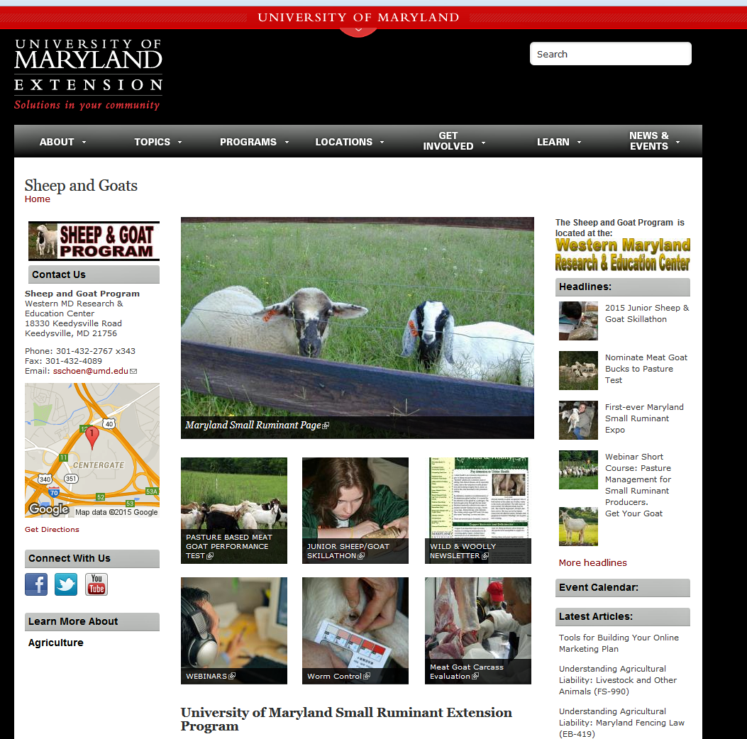
Small Ruminants
Susan Schoenian, Sheep and Goat specialist, Western Maryland Research & Education Center
Notes:
https://extension.umd.edu/sheep-goats

Slide 17
Susan’s SlideShare Content
Great source of continuing education for me.
2015 Small Ruminant Pasture Series
Susan has a lot of very current content
Notes:
http://www.slideshare.net/schoenian/pasture-session-1?related=1

Slide 18
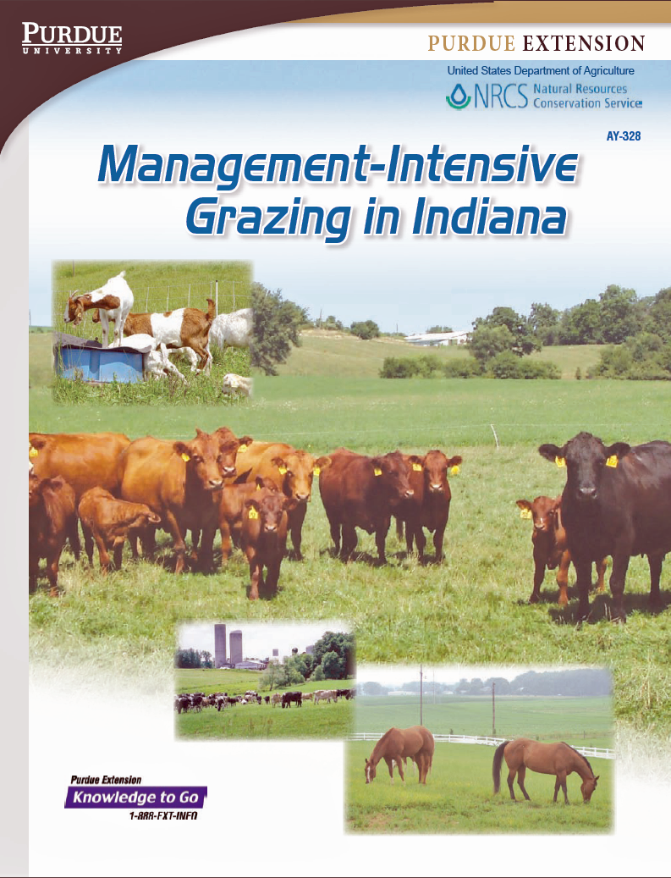
Notes:
https://www.extension.purdue.edu/extmedia/AY/ay-328.pdf

Slide 19
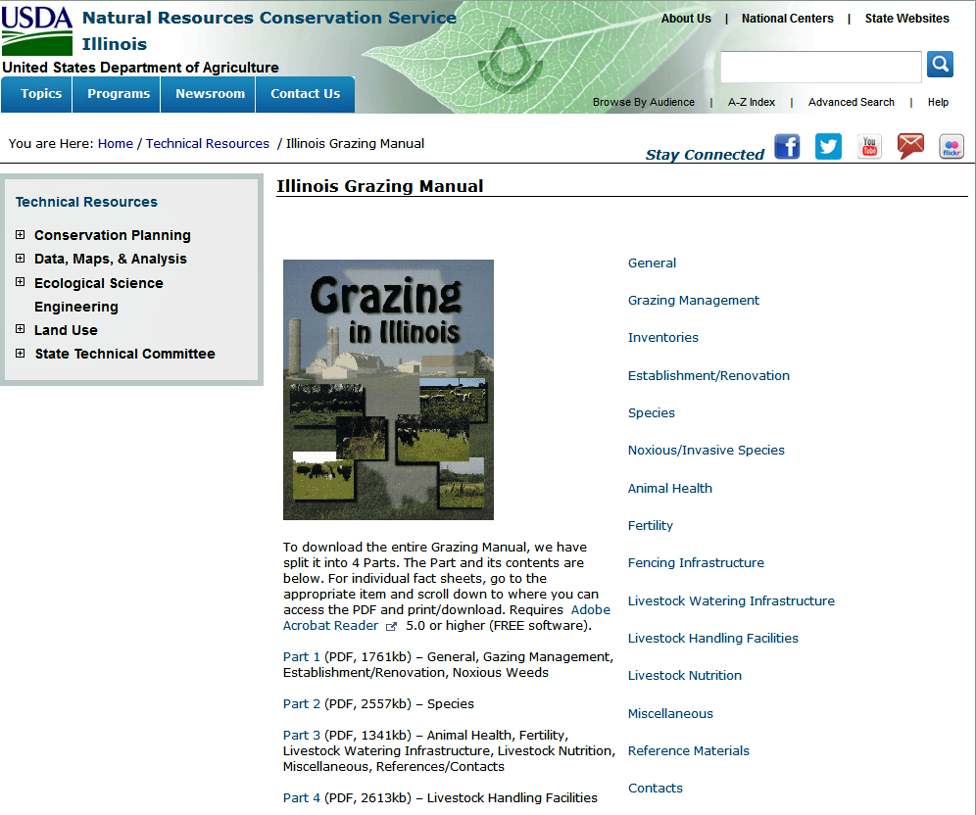
Notes:
http://www.nrcs.usda.gov/wps/portal/nrcs/detail/il/technical/?cid=nrcs141p2_030613

Slide 20
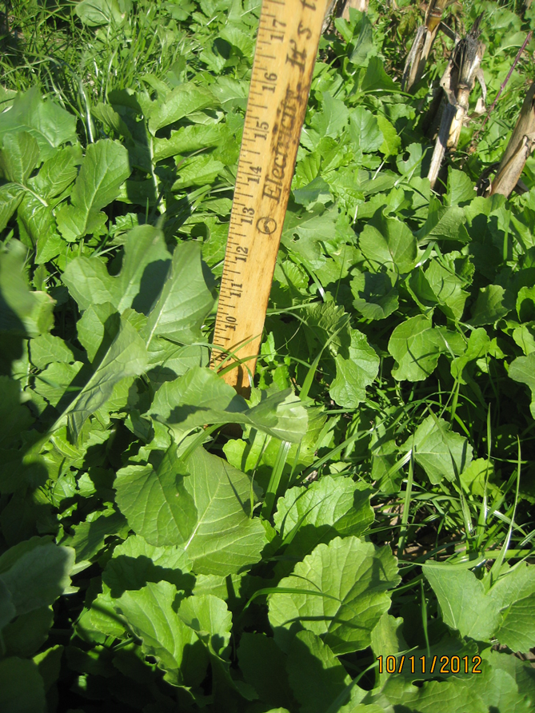
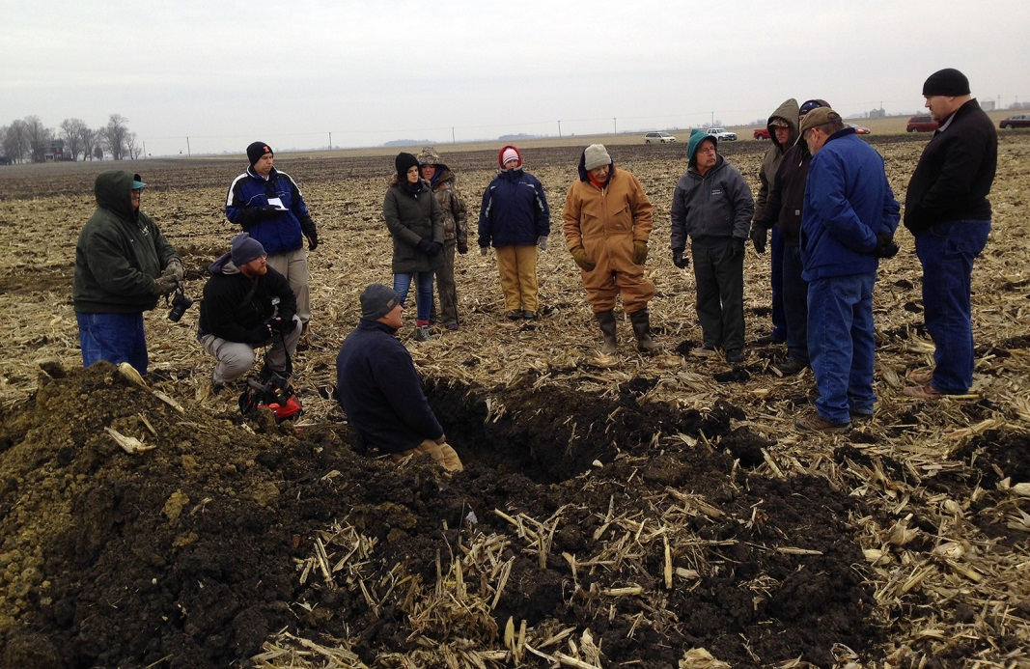
Early Harvested Corn – Seeded Sept. 5
Generating Interest among our few cow-calf producers
Notes:
Welcome! This is a quick overview of the basic features of the cluster call software.

Slide 21
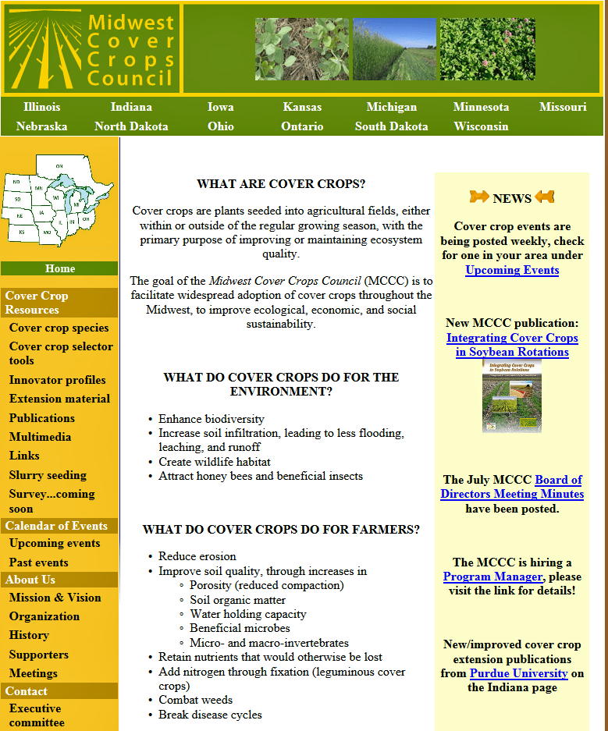
Cover Crop Selector
Cover Crop Species
Publications
Extension Materials
Notes:
http://www.mccc.msu.edu/

Slide 22
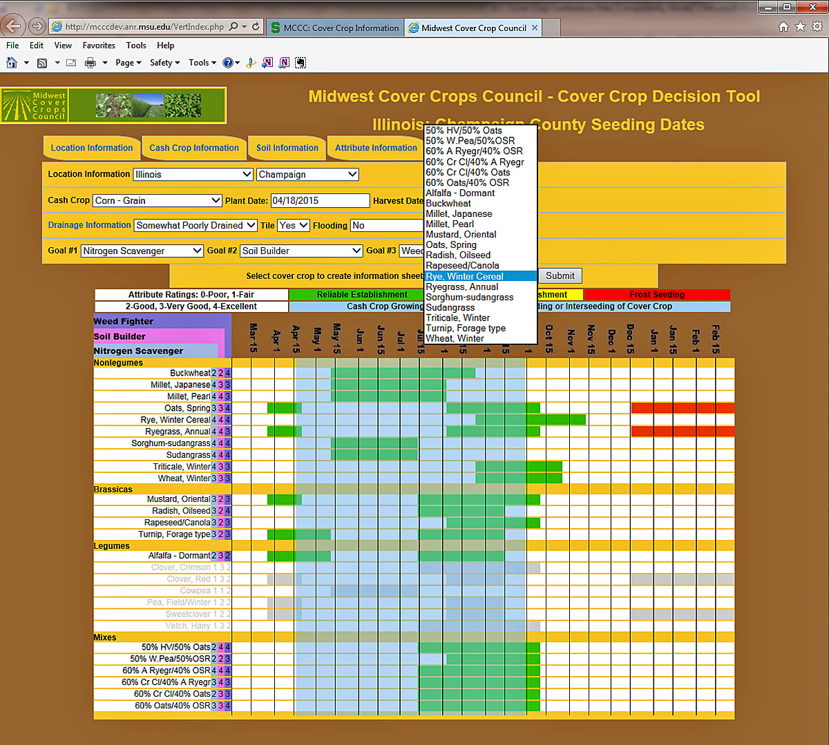
Notes:
http://mcccdev.anr.msu.edu/VertIndex.php

Slide 23
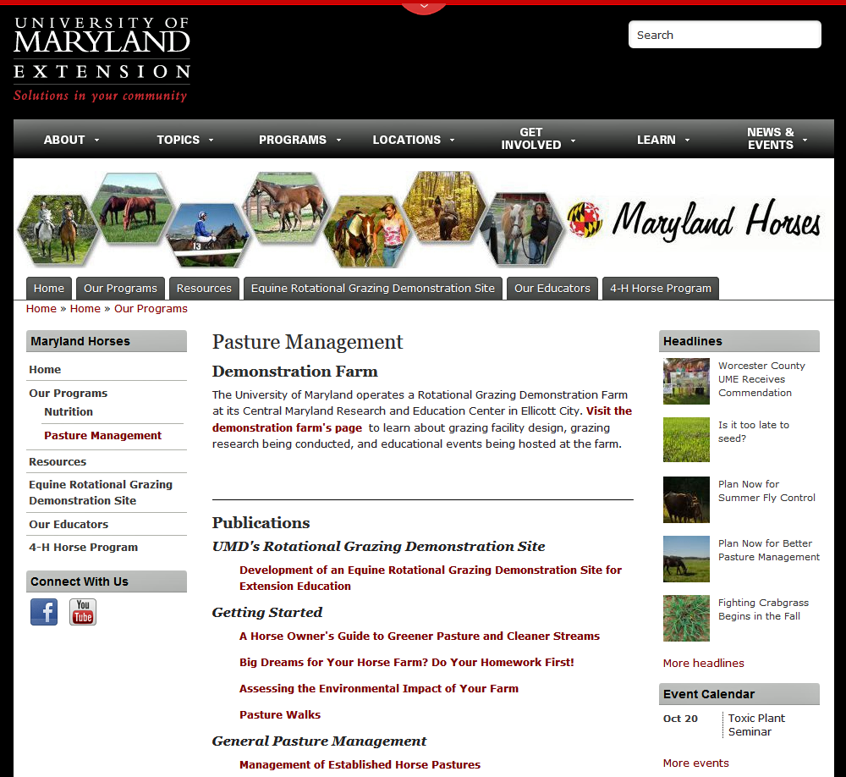
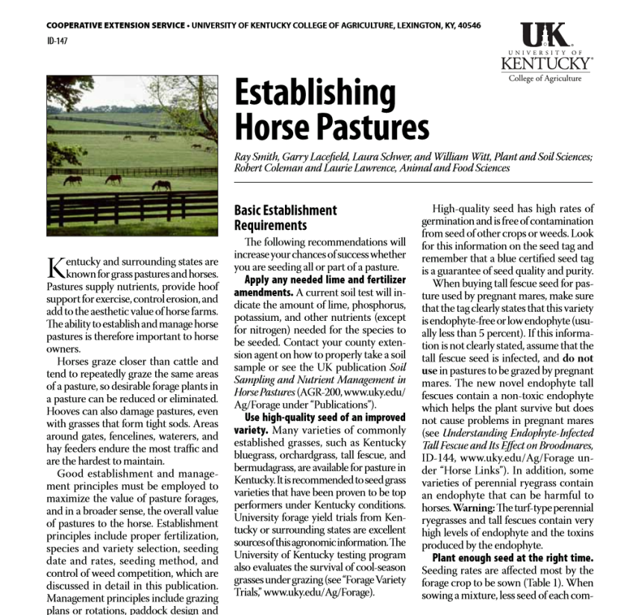
Horses and Pastures
Grazing or Exercise Yard?
Information
Horse States: Maryland & Kentucky
Notes:
http://extension.umd.edu/horses/our-programs/pasture-management
http://www2.ca.uky.edu/agc/pubs/id/id147/id147.pdf

Slide 24
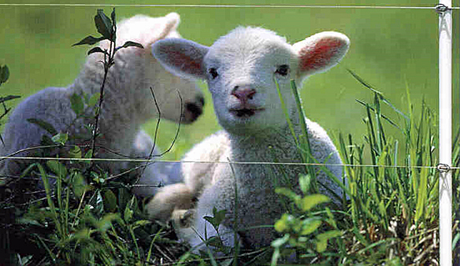
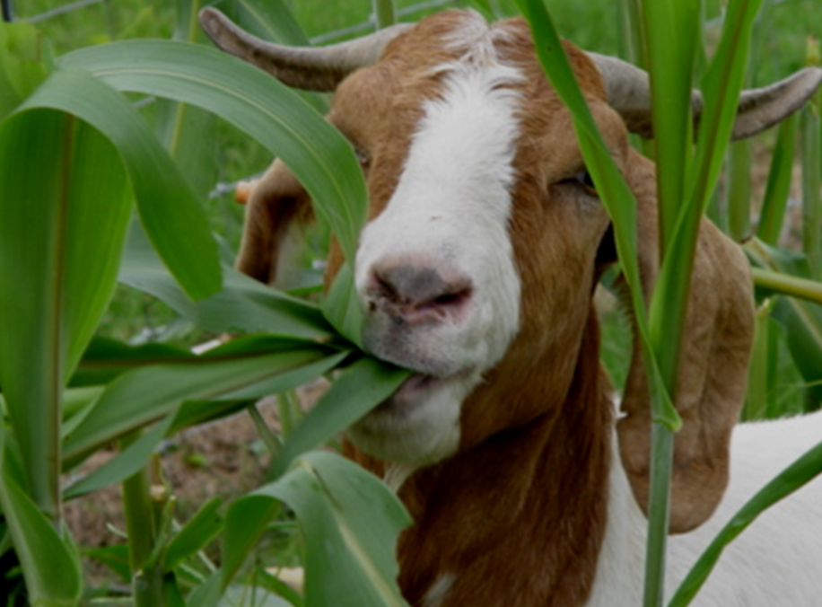
Notes:
Welcome! This is a quick overview of the basic features of the cluster call software.

Slide 25
Teaching Resources Roundtable Discussion:
Women Farmers & Landowners
Caroline van Schaik
Land Stewardship Project
October 9, 2015
2015 webinar series hosted by
Green Lands Blue Waters and The Pasture Project
Notes:
Thank you Jane and Warren for organizing this forum.
Like other members of Green Lands Blue Waters and the Pasture Project…
LSP is striving to help farmers and landowners act on their personal ethics in how and what decisions they make about their land.
We put a lot of emphasis on covered soil, on roots in the ground, and on the role livestock plays –
on a given farm and in the community.

Slide 26
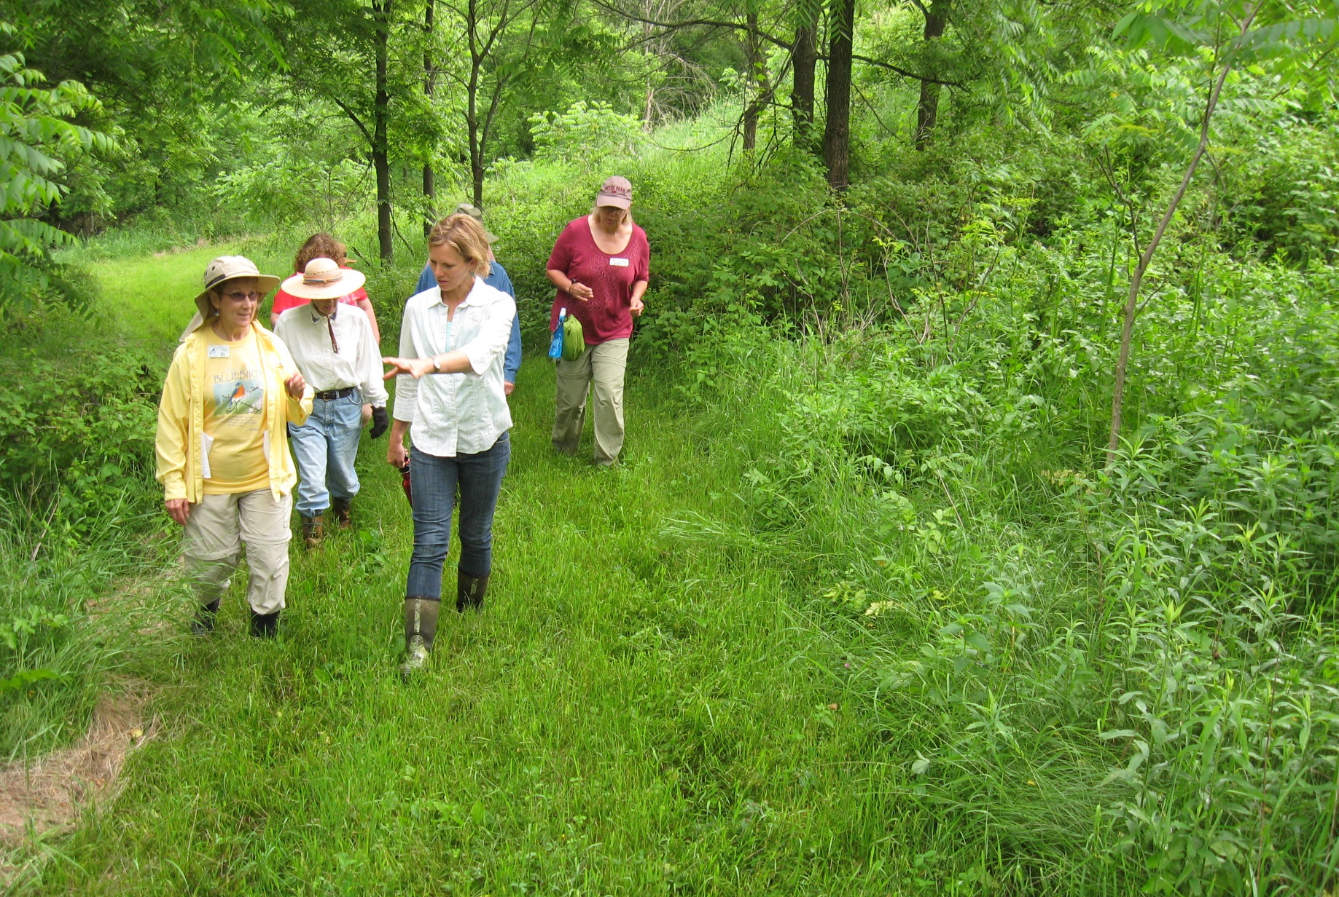
Notes:
And as have many of you, we have found a ready audience in women farmers and landowners …
Who own plenty of land just prime for active conservation and good farming.

Slide 27
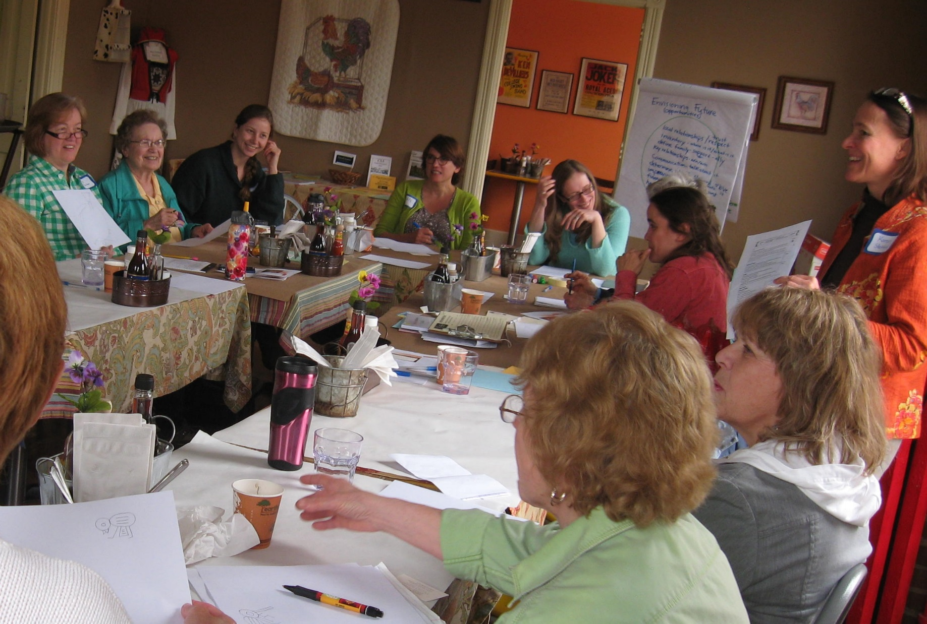
Notes:
These women have a desire to manage it well – even better - but many have very little or no experience making these kinds of decisions.
That was the role of their husbands, their grandpas or brothers, even long-time tenants.
But as land ownership shifts, women are emerging
as nascent keepers of the family acreage…
Managing family trusts and in-laws…
Siblings and children
And stepping up to learn in ways they never did in their growing up years.
They are often willing AND able to strike a different balance between management practices and profit…

Slide 28
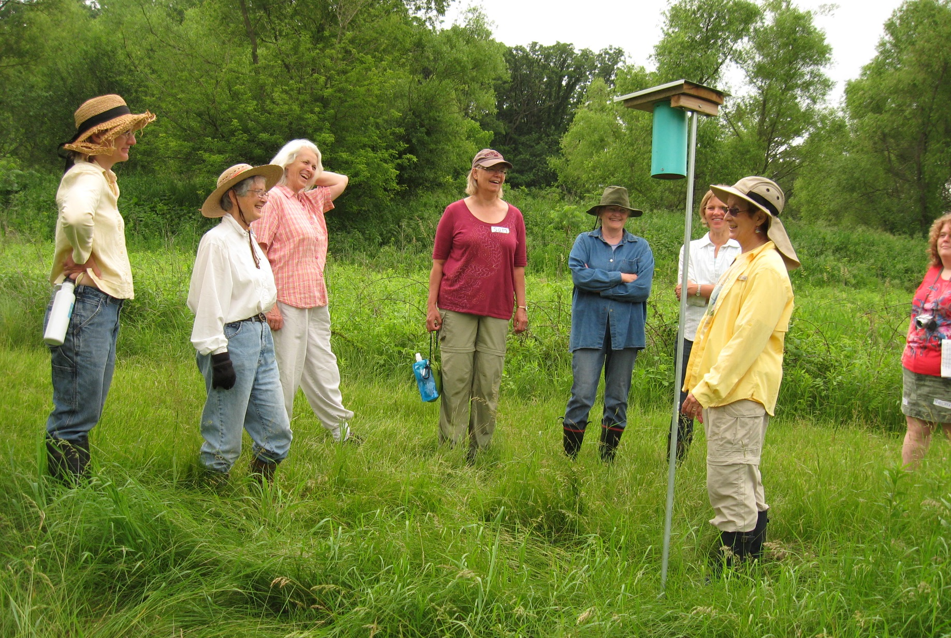
Notes:
They typically don’t speak what one woman called “farm-guy-ese” …
Some will have had off-putting experiences with ag professionals…
Or never set foot in an ag service center.

Slide 29
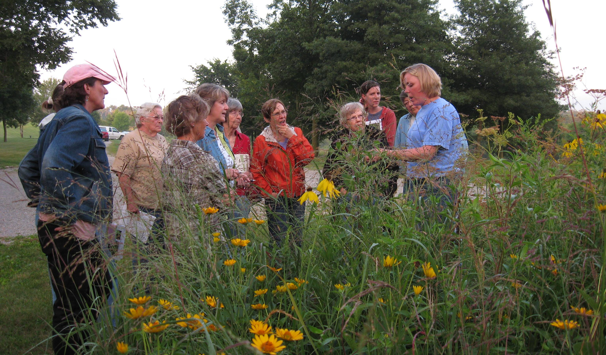
Notes:
And many of them really enjoy learning in the comfort of other women.
We credit Iowa’s Women, Food and Agriculture Network for raising up the learning circle method of conservation outreach to women…
And for designing an effective curriculum presented as a series of lessons (reference at end).
Like WFAN, LSP has noted the willingness of women to verbalize stewardship values …
And also their unique needs when it comes to learning and asserting their preferences for the land.
We started with the WFAN curriculum and although we’ve largely moved on from it,
We are clear about our shared goals: to help women move figuratively from the back of the room …
To articulate what’s most important to them about their land and …
And do something about it…
That looks closer to more farmers growing crops & livestock, good fishing, and plenty of songbirds.

Slide 30
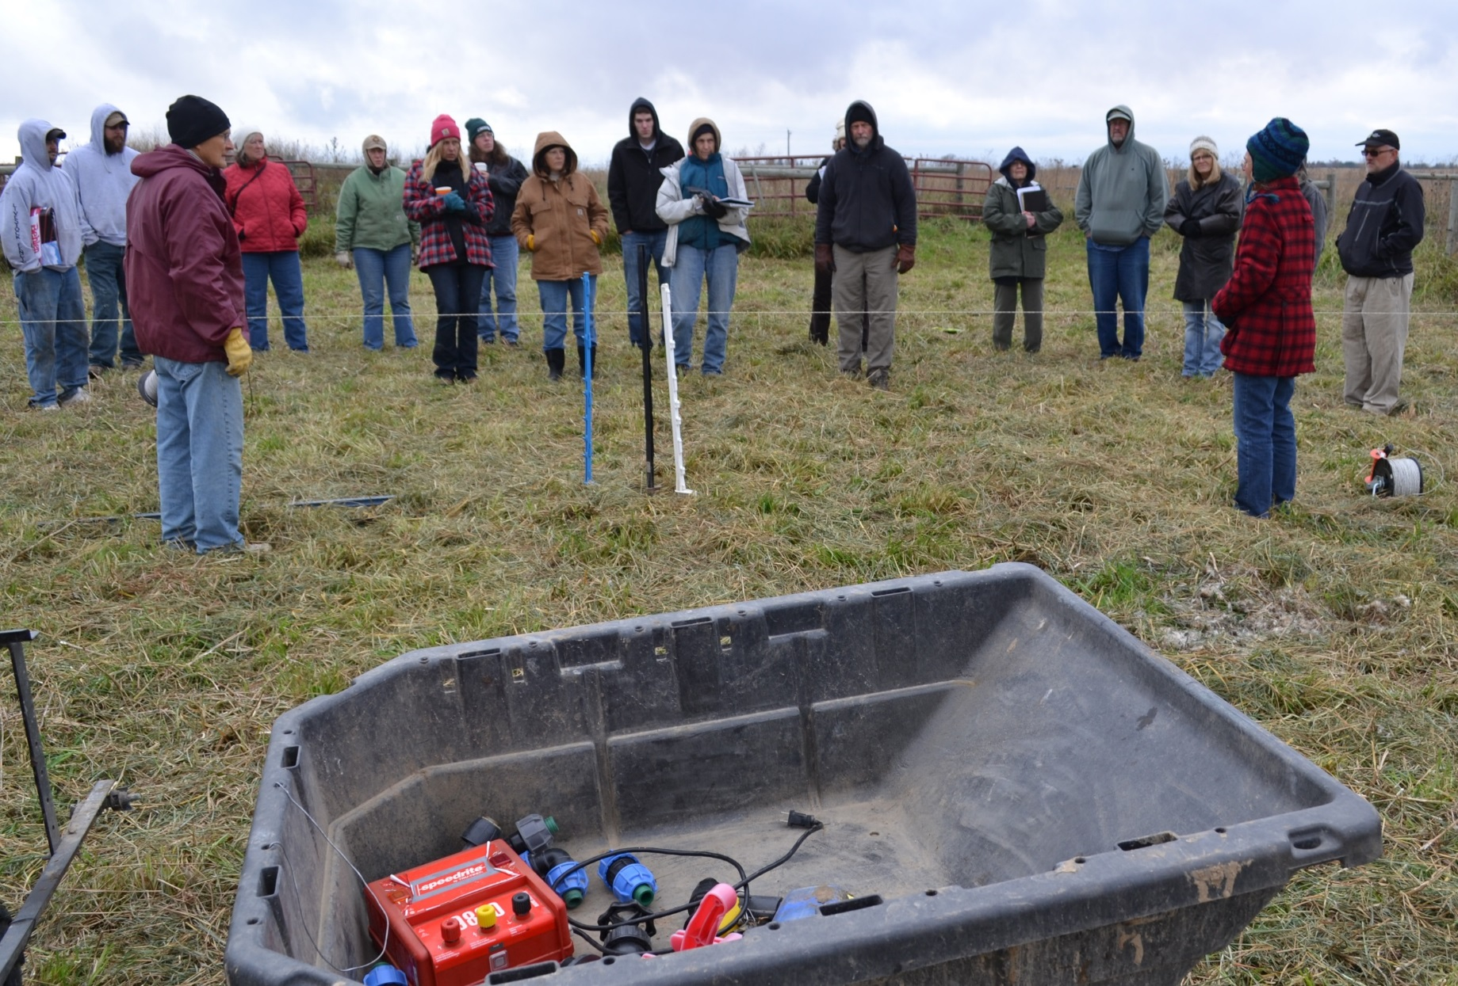
Notes:
Let me turn specifically to the issues that especially bring us together, those related to grazing.
When you bring up livestock in a group of these women,
it typically elicits head shaking and mutterings of “fences,” “winter,” “bulls.”
These are not issues unique to women who own land!
Plenty of women grew up within this context so that though they may not be raising animals now, they know the value of pasture and livestock for erosion control, stream health, aesthetics, wildlife habitat, and more.
But if they are renting out their land …

Slide 31
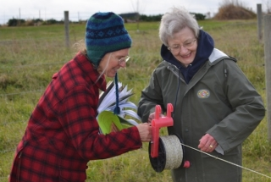
Notes:
They probably aren’t moving fence.
They do know the challenge of tenants…
The expectation to be nice...
(As though asserting their expectations for their land is anything else!)
And sometimes the fear of losing the guy who plows their driveway in winter
even if he plows over the grassy waterways in spring.

Slide 32
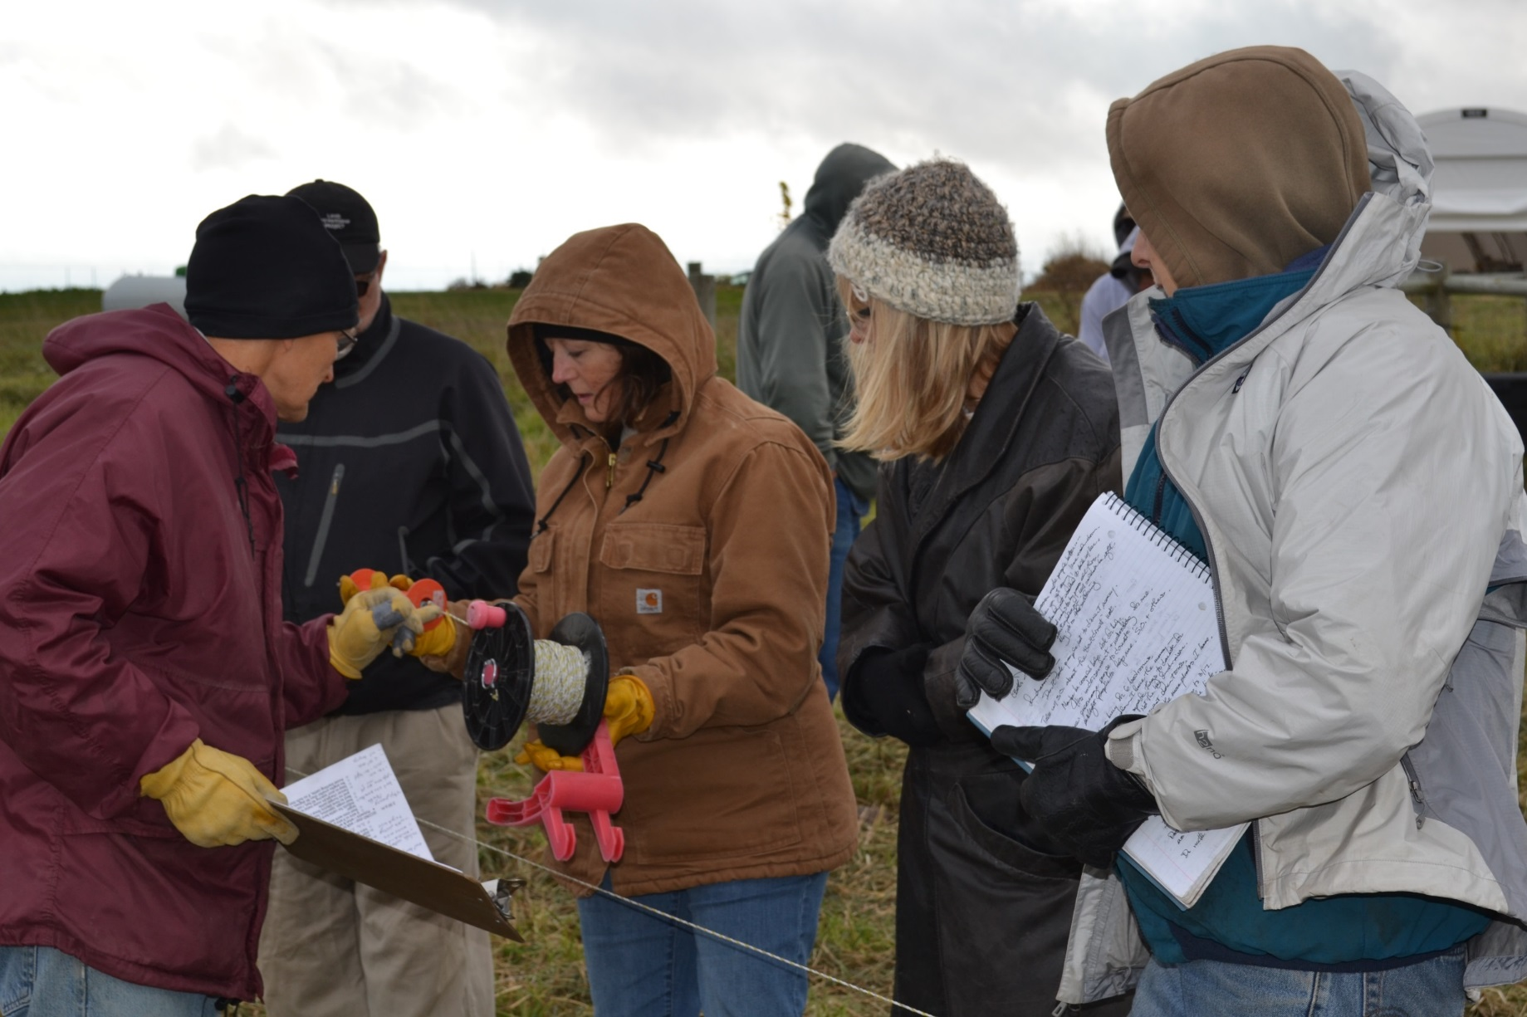
Notes:
It hasn’t necessarily occurred to them that someone else could pasture animals there…
Either to start grazing or\to expand an operation.
And as with many male landowners, a good signed lease is often little more than a good idea.
So there is plenty of room to reach out with grazing expertise in non-Farm-Guy-ese language.
I find women very responsive to some important first questions:
How do livestock and pasture and grazing
Address her stewardship priorities?
What else is inspiring her:
Is there a neighbor or a beginning farmer she hopes to help?
Are there income needs?
Does she want more songbirds, better hunting, a cleaner stream?
And also: what about calving on pasture, or having a stranger on her farm, and yes, the snow plow option?
How engaged does she want to be day to day?

Slide 33
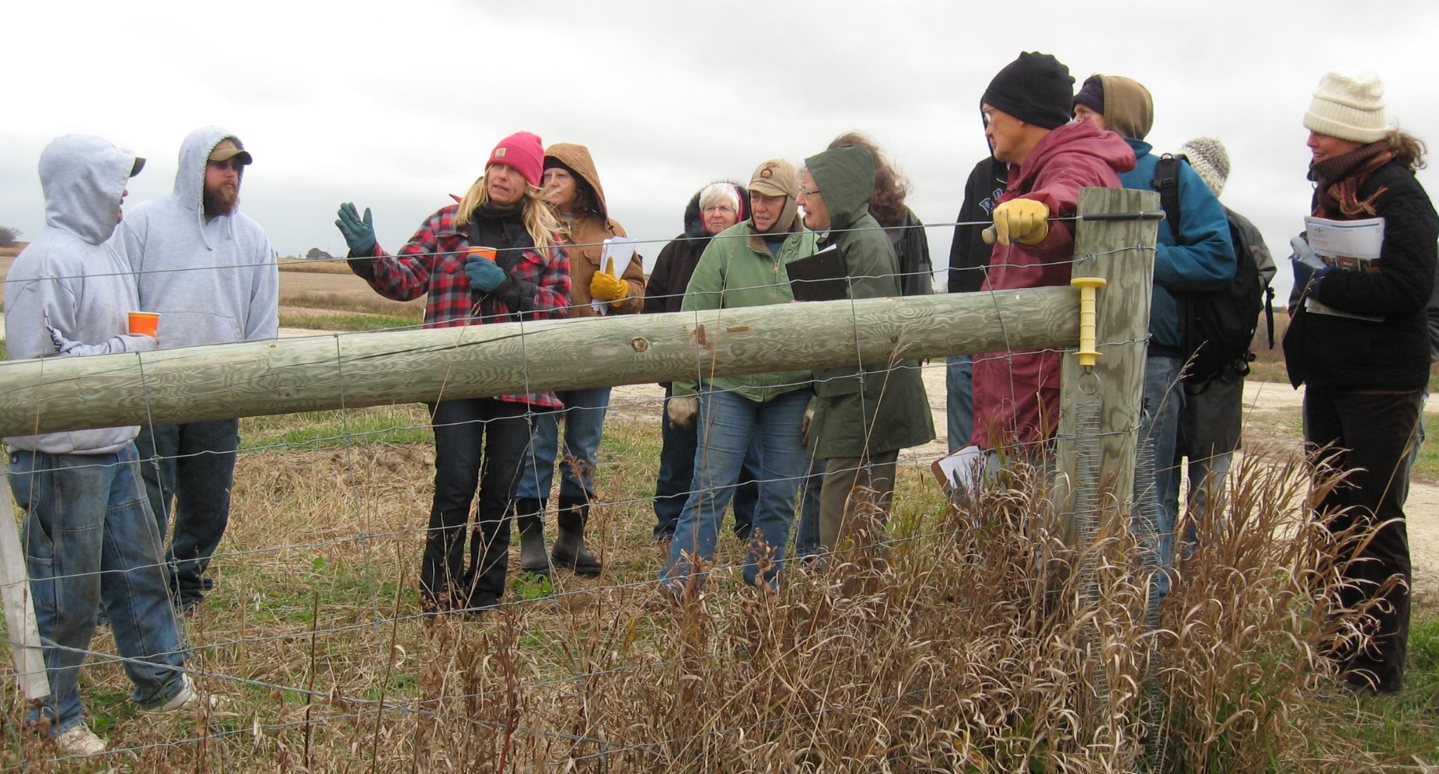
Notes:
And then there are the nitty-gritties: …
Does she have conservation plan?
…startup costs (incl transition from row crops to pasture)
…fencing/fence-builder + water + electricity
How to find a livestock producer and/or grazier in a custom or contract situation
What about a sensible and signed lease
What are the programs to help her financially

Slide 34
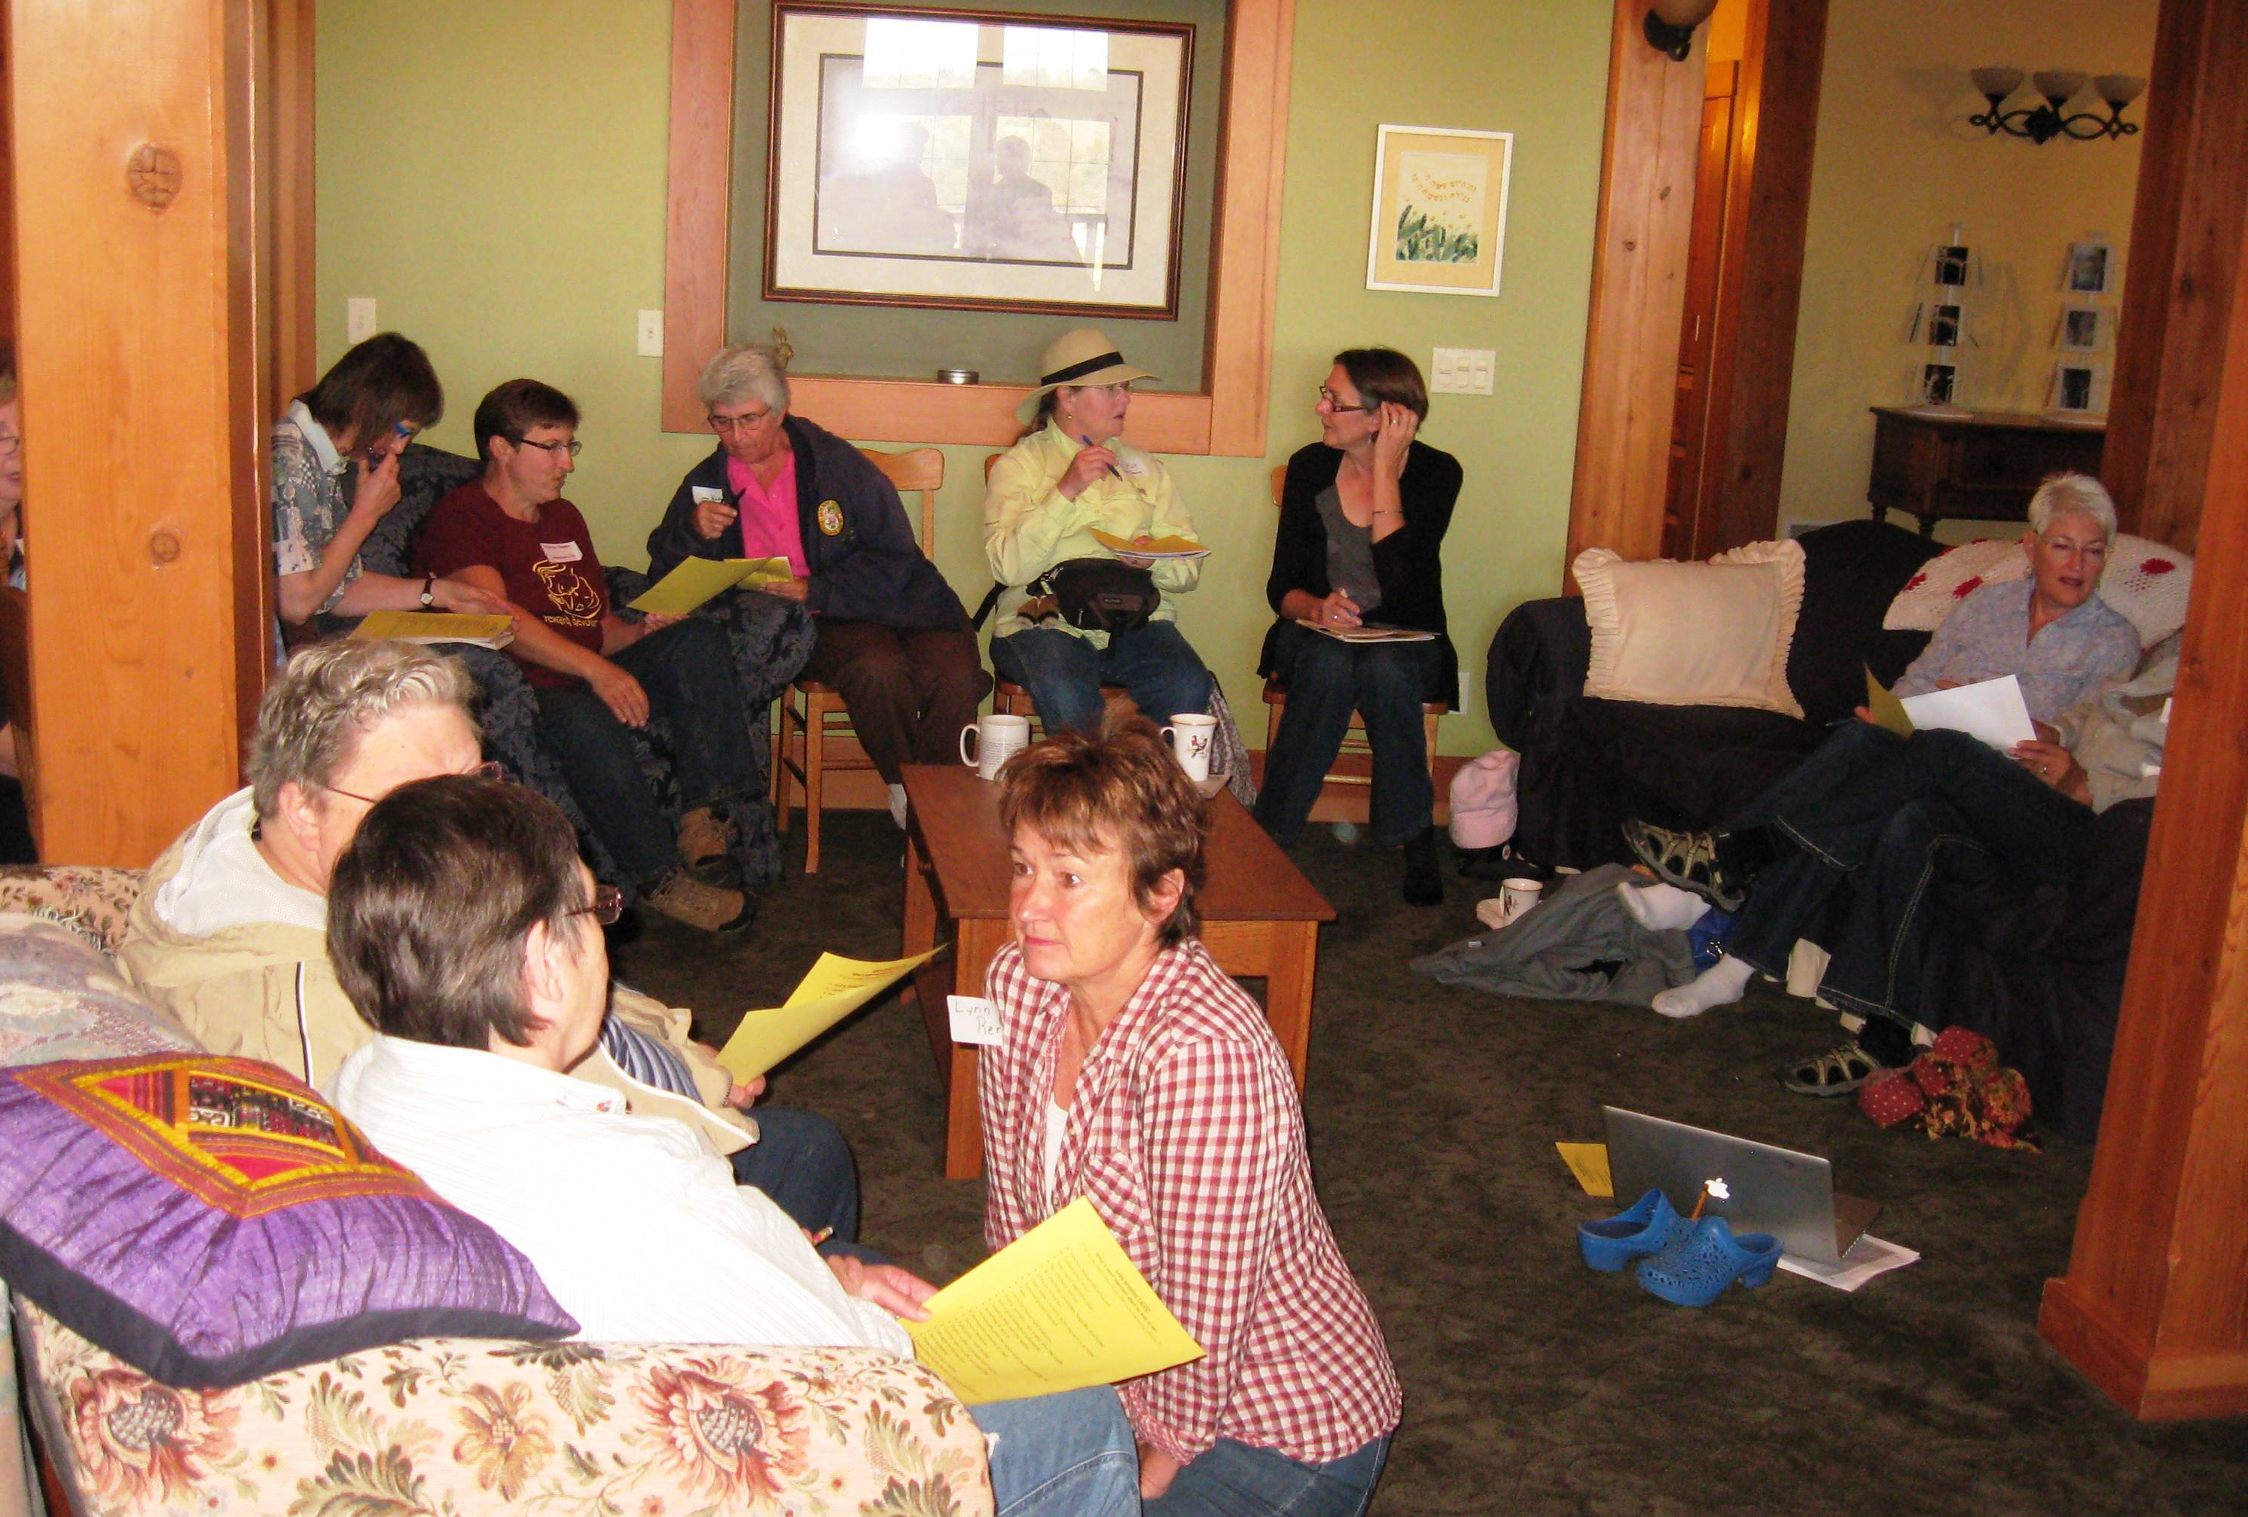
Notes:
We’ve hosted meetings with women farmers and landowners…
On some of those issues and many others - agronomic, soil science, conservation, and stewardship.
They tend to have these characteristics:
…Start with values exercise as the foundation for the day’s work
…often on a farm, almost always a pretty site
…indoors and outside
…women only, at least at first: morning women, afternoon public field event; lawyer and soil scientist after women discussed their farms and values
Opportunities for women to think silently by themselves and then to work together
Very practical, what-next-oriented with a constant check-back to personal values as the guiding decision-maker.
By virtue of your interest in managed grazing, you’re standing up for more cover…
And more living roots in the ground.
Women farmers and landowners are a source of these landscape features…
IF we acknowledge that we’ll get their attention in different ways…
Apart from the familiar farm meetings delivered by men.
They could use our collective help –
and in turn, this group of farmers and landowners
could provide significant landscape change.

Slide 35
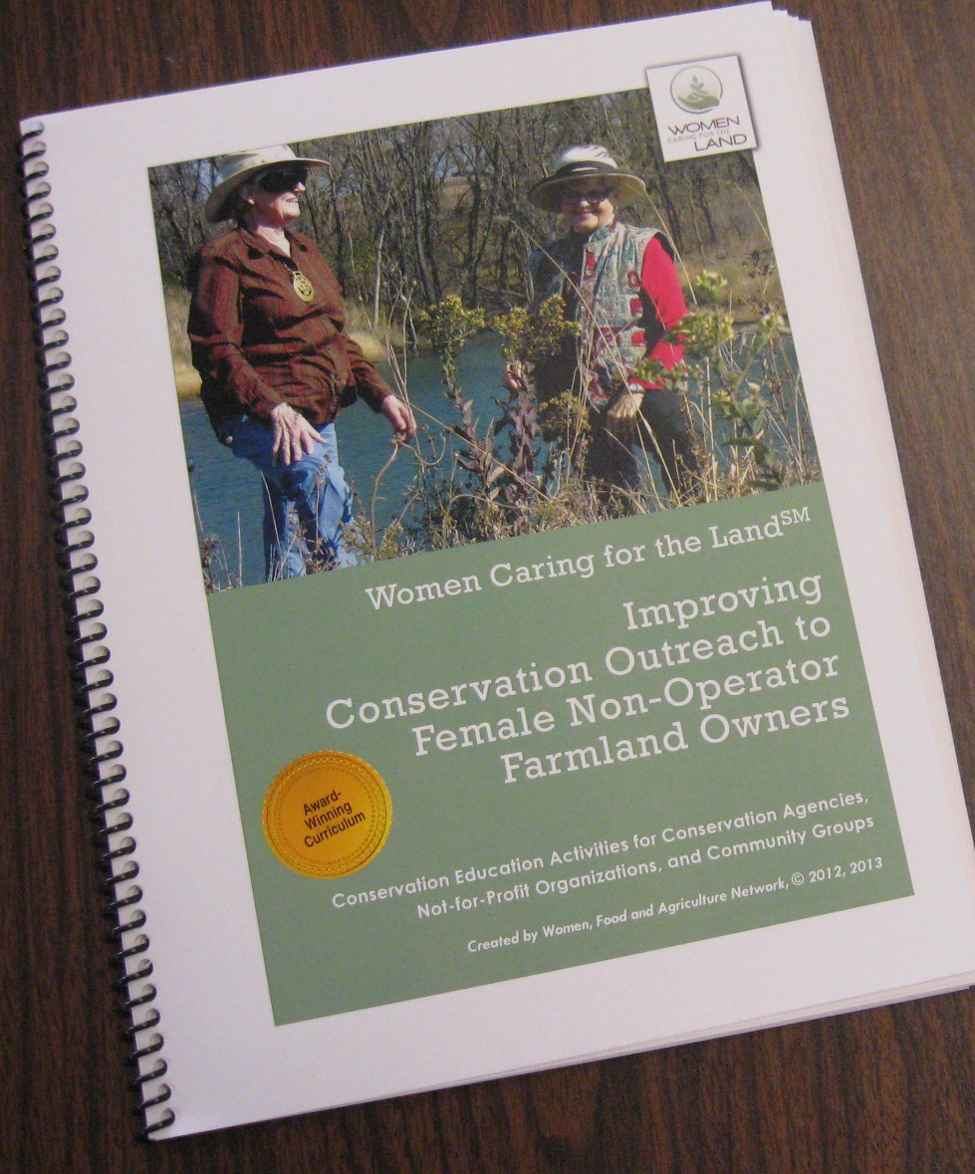
Women, Food and Agriculture Network
info@wfan.org
515-460-2477
www.womencaringfortheland.org
Notes:
For the curriculum designed and used regularly by WFAN.

Slide 36
Caroline van Schaik
Land Stewardship Project
180 E. Main St. Lewiston, MN 55952
caroline@landstewardshipproject.org
507-523-3366 (ext. 102)
Notes:
1. And of course please feel free to contact me if you want to go further on anything here.
2. Thank you for listening,
3. and again, my thanks to the
4. Pasture Project and Green Lands Blue Waters for naming women farmers and landowners as a bonafida resource in shifting our landscape to something better.

Slide 37
Pasture Walk Method
Vance Haugen
University of Wisconsin Extension
October 2015

Slide 38
Great River Graziers Pasture Rules
Rule Number 1:
At this official and sanctioned Great River Grazier Pasture walk one person talks and the rest listen because if John has the answer to Ted’s question but he is talking to Ann no education gets done, and we want to tap all the available knowledge present.

Slide 39
Pasture Walk Rules Continued
A corollary to rule number 1 is if people are listening, an answer need only be given once and therefore the farmer or speaker isn’t answering the same question over and over again.

Slide 40
Great River Graziers Pasture Rules
Rule Number 2:
We want you to disagree but disagree agreeably. Do not draw blood and no personal attacks.

Slide 41
Pasture Walk Rules Continued
A corollary to rule number 2 is if people put forth their observations or deductions they must be ready and able to back their statements with data or research. Beliefs, feeling or tradition is not a substitute for facts, but vigorous discussion with personal observations and multi year usage of a practice is encouraged.

Slide 42
Useful Materials For Pasture Education
Grazing Systems Planning
http://www.extension.umn.edu/agriculture/dairy/grazing-systems/grazing-systems-handbook.pdf,
Identifying Pasture Grasses
http://pss.uvm.edu/pdpforage/Materials/ID/A3637_GrassID_UWis.PDF,
Identification of Legumes
http://www.midwestforage.org/pdf/404.pdf.pdf,

Slide 43
Useful Materials For Pasture Education
Common Pasture Grasses and Legumes
http://www.extension.umn.edu/agriculture/horse/pasture/docs/common-pasture-grasses-and-legumes.pdf,
Early Version of “The Pasture Walk Method”
http://crawford.uwex.edu/files/2010/05/The-Pasture-walk-method-2012.pdf,

Slide 44
Using the “Pasture Walk Teaching System” for your outdoor educational event.
https://drive.google.com/file/d/0By_iaxS75L8oRkJuYzJCSEU5R28/view?usp=sharing,

Slide 45
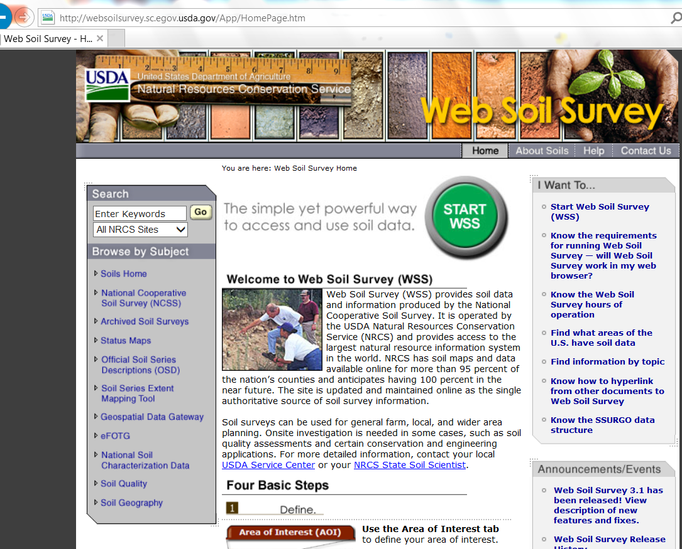

Slide 46
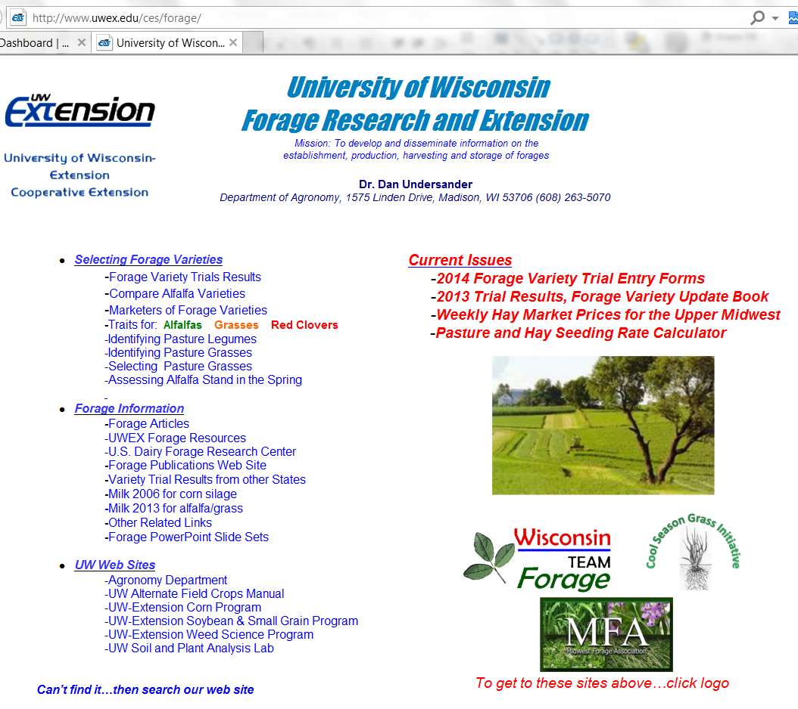

Slide 47
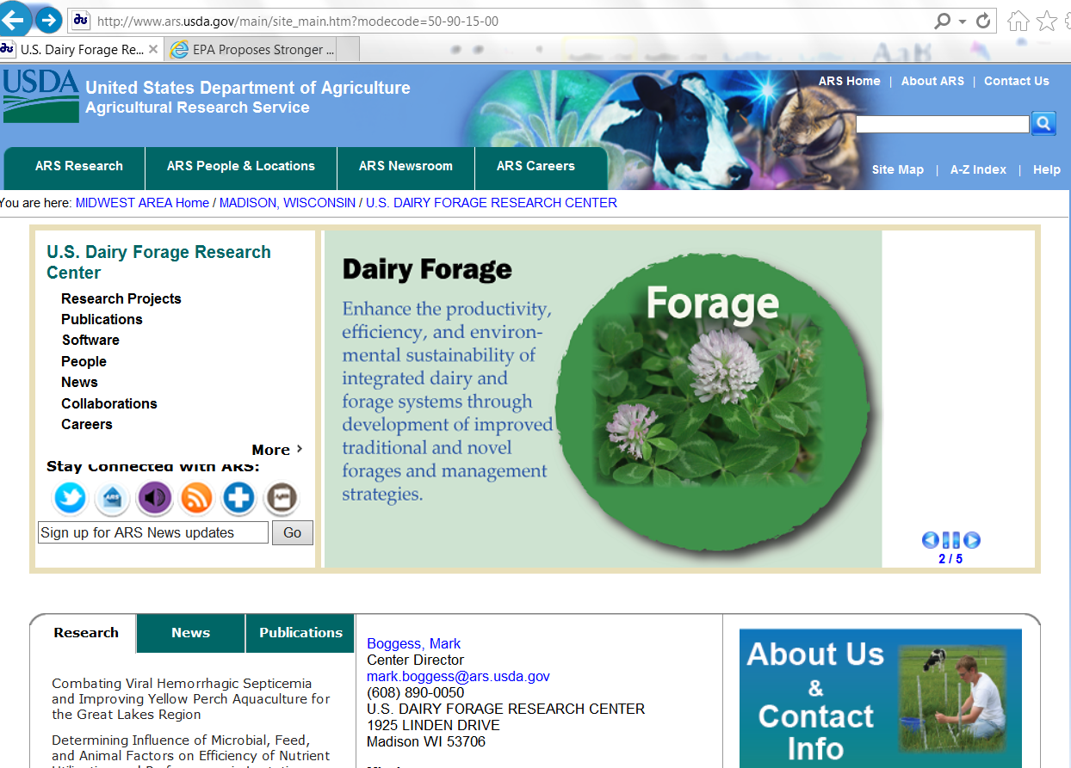

Slide 48
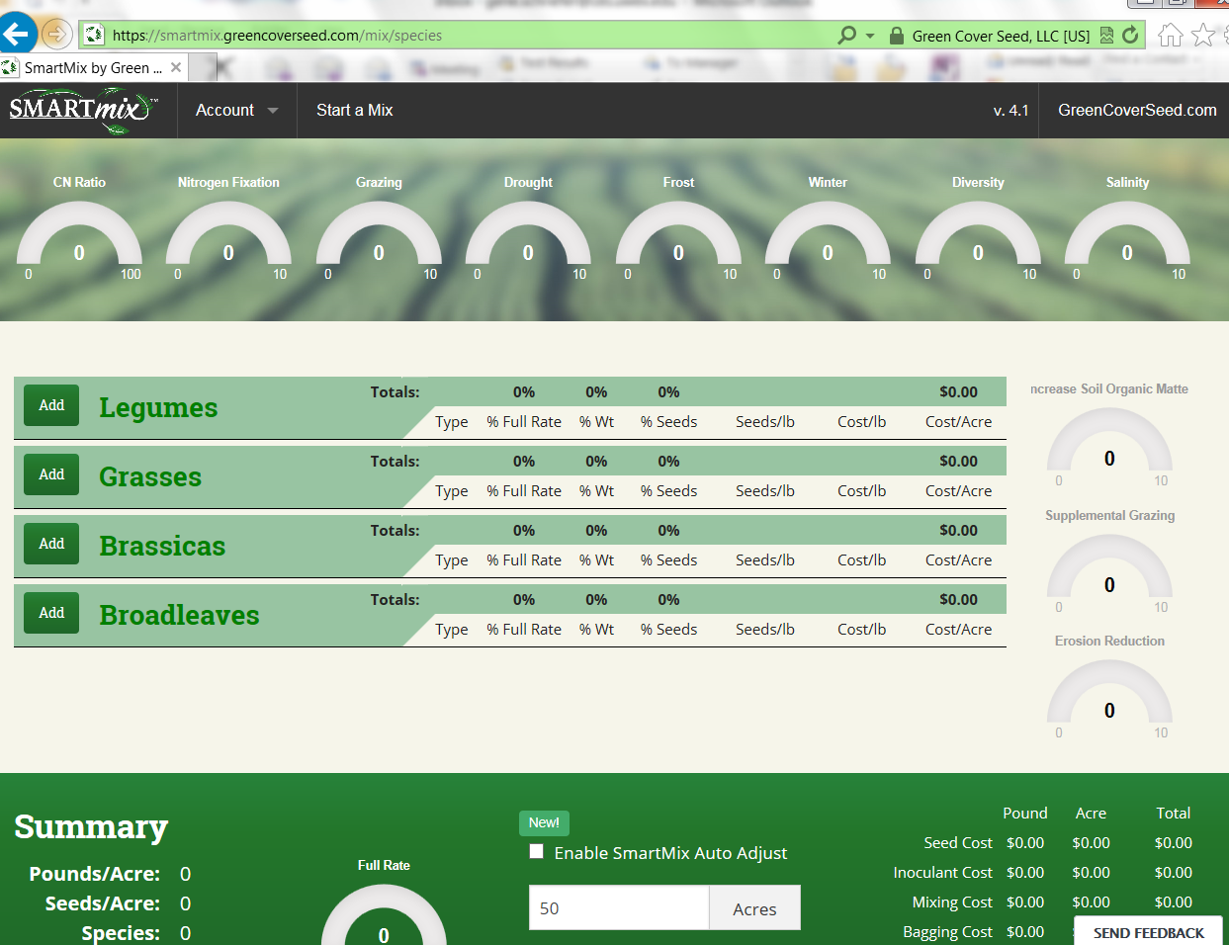

Slide 49
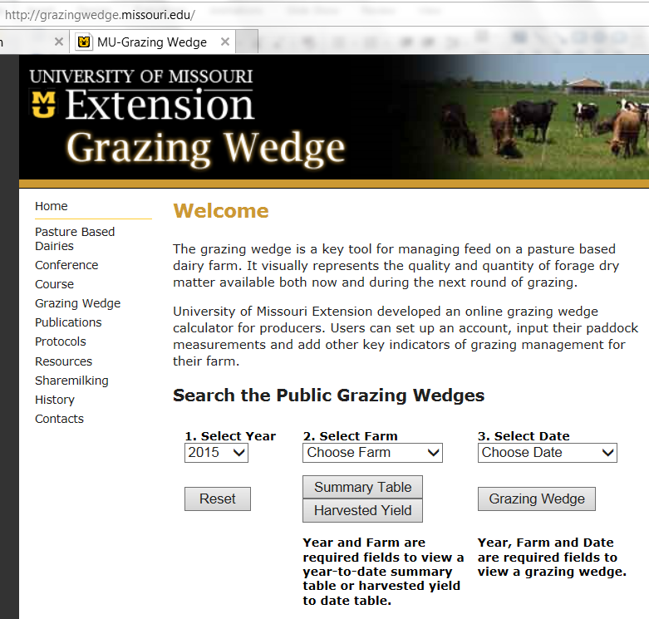

Slide 50
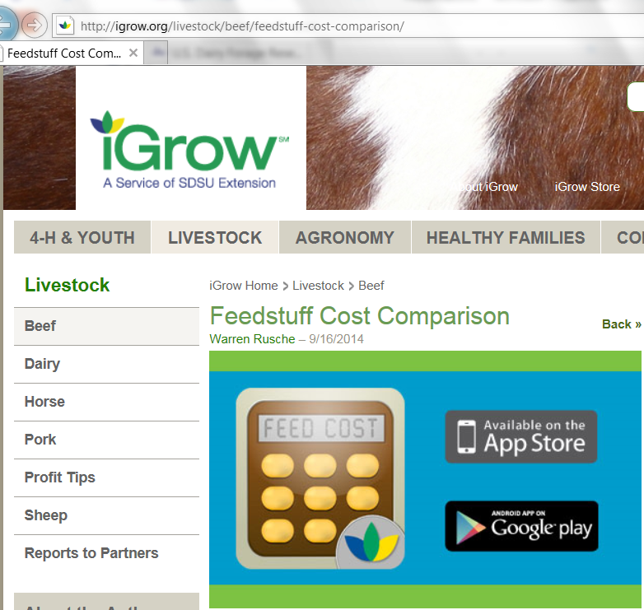

Slide 51
The Webinar Series
http://greenlandsbluewaters.net/Perennial_Forage/grz_ed_webnr.html

Slide 52
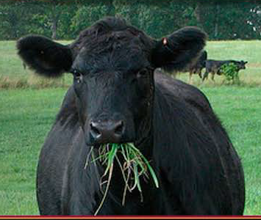
Thank you!

