Slide 1
Managed Grazing for Dairy Profits
Charts from:
“Grazing Dairies: Production, Income & Expenses” http://greenlandsbluewaters.net/Perennial_Forage/Dairy_Grazing_Production_Income_Expenses.pdf
Companion piece to:
“Profitability Centers on Managed Grazing Dairies” http://greenlandsbluewaters.net/Perennial_Forage/Profitability_Centers_Managed_Grazing_Dairies.pdf

Slide 2
$
Data sources: 1) Profitability Centers on Managed Grazing Dairies. 2018. Managed Grazing for Dairy Profits,” Midwest Perennial Forage Working Group, Green Lands Blue Waters. www.greenlandsbluewaters.net/dairy.html. Study conducted with funding from USDA-Risk Management Agency. 2) AgFA benchmark data from 2015-2017, Center for Dairy Profitability, University of Wisconsin-Madison.
Notes:
The data for this slide comes from the Total Farm Income line, line #7 in the left-hand column of Spreadsheets 1 & 2 in Profitability Centers on Managed Grazing Dairies.

Slide 3
Data sources: 1) Profitability Centers on Managed Grazing Dairies. 2018. Managed Grazing for Dairy Profits,” Midwest Perennial Forage Working Group, Green Lands Blue Waters. www.greenlandsbluewaters.net/dairy.html. Study conducted with funding from USDA-Risk Management Agency. 2) AgFA benchmark data from 2015-2017, Center for Dairy Profitability, University of Wisconsin-Madison.
Notes:
The data for this slide comes from the Total Allocated Costs line, line #12 in the left-hand column of Spreadsheets 1 & 2 in Profitability Centers on Managed Grazing Dairies.

Slide 4
Data sources: 1) Profitability Centers on Managed Grazing Dairies. 2018. Managed Grazing for Dairy Profits,” Midwest Perennial Forage Working Group, Green Lands Blue Waters. www.greenlandsbluewaters.net/dairy.html. Study conducted with funding from USDA-Risk Management Agency. 2) AgFA benchmark data from 2015-2017, Center for Dairy Profitability, University of Wisconsin-Madison.

Slide 5
Data sources: 1) Profitability Centers on Managed Grazing Dairies. 2018. Managed Grazing for Dairy Profits,” Midwest Perennial Forage Working Group, Green Lands Blue Waters. www.greenlandsbluewaters.net/dairy.html. Study conducted with funding from USDA-Risk Management Agency. 2) AgFA benchmark data from 2015-2017, Center for Dairy Profitability, University of Wisconsin-Madison.
Notes:
The data for this slide comes from the Average Number of Cows in Herd line, line #1 in the left-hand column of Spreadsheets 1 & 2 in Profitability Centers on Managed Grazing Dairies.

Slide 6
Data sources: 1) Profitability Centers on Managed Grazing Dairies. 2018. Managed Grazing for Dairy Profits,” Midwest Perennial Forage Working Group, Green Lands Blue Waters. www.greenlandsbluewaters.net/dairy.html. Study conducted with funding from USDA-Risk Management Agency. 2) AgFA benchmark data from 2015-2017, Center for Dairy Profitability, University of Wisconsin-Madison.
Notes:
The data for this slide comes from the Quantity- pounds milk line in Table 1 in Profitability Centers on Managed Grazing Dairies.

Slide 7
Data sources: 1) Profitability Centers on Managed Grazing Dairies. 2018. Managed Grazing for Dairy Profits,” Midwest Perennial Forage Working Group, Green Lands Blue Waters. www.greenlandsbluewaters.net/dairy.html. Study conducted with funding from USDA-Risk Management Agency. 2) AgFA benchmark data from 2015-2017, Center for Dairy Profitability, University of Wisconsin-Madison.
Notes:
The data for this slide is calculated from data in Table 1 of Profitability Centers on Managed Grazing Dairies. The Total Income per Cow is shown in Table 1, and includes sales of milk, culls, and any other income related to the cow herd (e.g. bull calves). Total Income per Cow is divided by the average milk price to give CWT Equivalent.

Slide 8
Data sources: 1) Profitability Centers on Managed Grazing Dairies. 2018. Managed Grazing for Dairy Profits,” Midwest Perennial Forage Working Group, Green Lands Blue Waters. www.greenlandsbluewaters.net/dairy.html. Study conducted with funding from USDA-Risk Management Agency. 2) AgFA benchmark data from 2015-2017, Center for Dairy Profitability, University of Wisconsin-Madison.
Notes:
Figures on this slide are calculated as Average Net Farm Income/Average Number of Cows per Farm

Slide 9
Data sources: 1) Profitability Centers on Managed Grazing Dairies. 2018. Managed Grazing for Dairy Profits,” Midwest Perennial Forage Working Group, Green Lands Blue Waters. www.greenlandsbluewaters.net/dairy.html. Study conducted with funding from USDA-Risk Management Agency. 2) AgFA benchmark data from 2015-2017, Center for Dairy Profitability, University of Wisconsin-Madison.
Notes:
The figures on this slide are calculated as: Average Net Farm Income/(Average Number of Cows per Farm x Actual CWT per Cow)

Slide 10
Data sources: 1) Profitability Centers on Managed Grazing Dairies. 2018. Managed Grazing for Dairy Profits,” Midwest Perennial Forage Working Group, Green Lands Blue Waters. www.greenlandsbluewaters.net/dairy.html. Study conducted with funding from USDA-Risk Management Agency. 2) AgFA benchmark data from 2015-2017, Center for Dairy Profitability, University of Wisconsin-Madison.
Notes:
The figures on this slide are calculated as: Average Net Farm Income/(Average Number of Cows per Farm x CWT Equivalent per Cow)

Slide 11
Data sources: 1) Profitability Centers on Managed Grazing Dairies. 2018. Managed Grazing for Dairy Profits,” Midwest Perennial Forage Working Group, Green Lands Blue Waters. www.greenlandsbluewaters.net/dairy.html. Study conducted with funding from USDA-Risk Management Agency. 2) AgFA benchmark data from 2015-2017, Center for Dairy Profitability, University of Wisconsin-Madison.
Notes:
The figures on this slide are calculated as: Average Net Farm Income/(Average Number of Cows per Farm x CWT Equivalent per Cow)

Slide 12
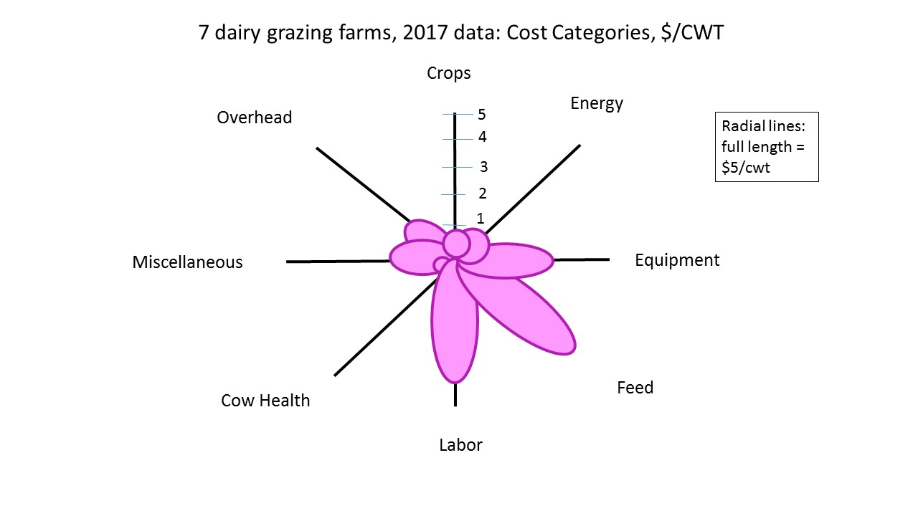
Data sources: 1) Profitability Centers on Managed Grazing Dairies. 2018. Managed Grazing for Dairy Profits,” Midwest Perennial Forage Working Group, Green Lands Blue Waters. www.greenlandsbluewaters.net/dairy.html. Study conducted with funding from USDA-Risk Management Agency. 2) AgFA benchmark data from 2015-2017, Center for Dairy Profitability, University of Wisconsin-Madison.
Notes:
The figures on this slide are calculated as: Average Net Farm Income/(Average Number of Cows per Farm x CWT Equivalent per Cow)

Slide 13
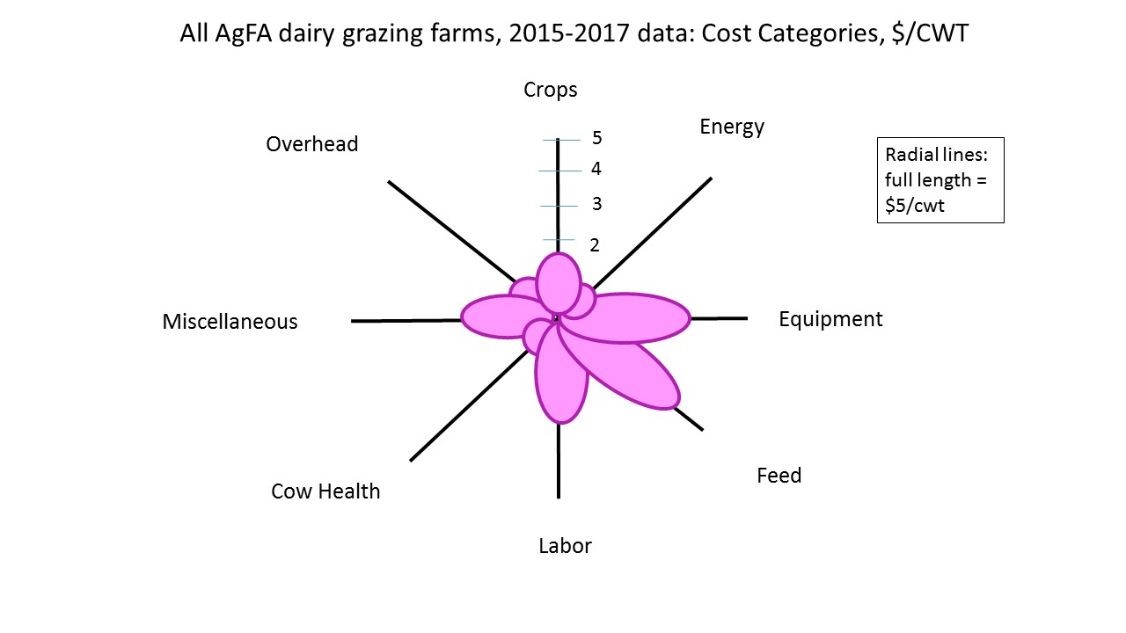
Data sources: 1) Profitability Centers on Managed Grazing Dairies. 2018. Managed Grazing for Dairy Profits,” Midwest Perennial Forage Working Group, Green Lands Blue Waters. www.greenlandsbluewaters.net/dairy.html. Study conducted with funding from USDA-Risk Management Agency. 2) AgFA benchmark data from 2015-2017, Center for Dairy Profitability, University of Wisconsin-Madison.
Notes:
The figures on this slide are calculated as: Average Net Farm Income/(Average Number of Cows per Farm x CWT Equivalent per Cow)

